Slide 1
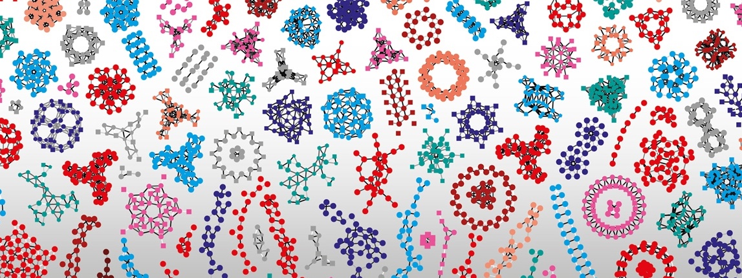

SIB Swiss Institute of Bioinformatics
Introduction to Deep Learning, November, 2023
Thuong Van Du Tran, and Markus Müller

Slide 2
TOC
History of deep learning
Principals of deep learning
How do deep neural nets learn
How do deep neural nets generalize
Biological and medical applications

Slide 3

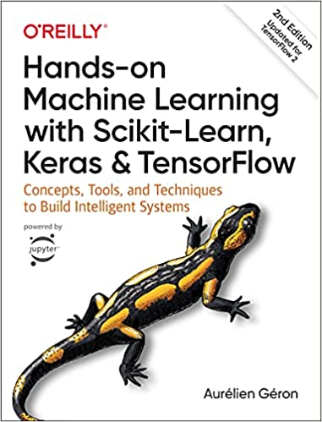
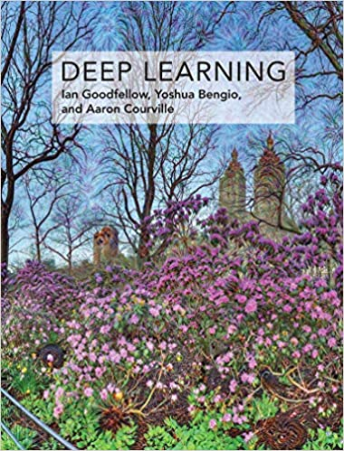
Learning deep learning
Coursera: Andrew Ng lecture
MIT 6.S191 Deep learning intro
https://www.kaggle.com/learn/intro-to-deep-learning
https://theaisummer.com/
The carpentries incubator deep learning intro
Tensorflow or PyTorch docs
https://playground.tensorflow.org/

Slide 4
History of deep learning

Slide 5
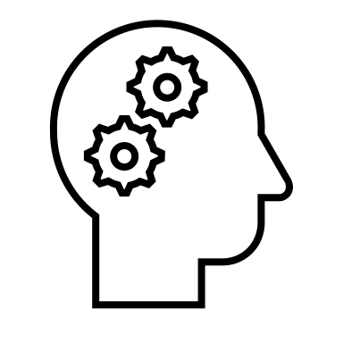
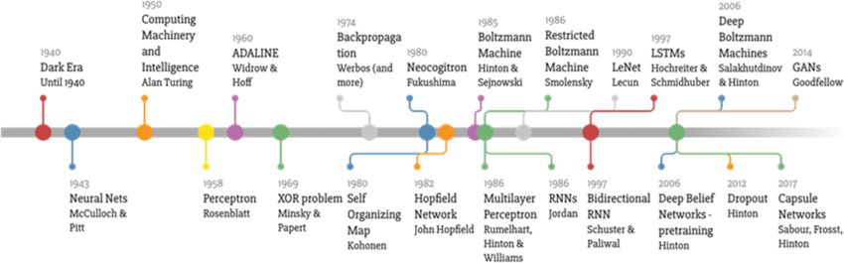
A bit of deep learning (DL) history
Markus Müller
Made by Favio Vazquez
See also:
https://www.dataversity.net/brief-history-deep-learning/
LeCun et al. Nature, 2015
Geoffrey Hinton: The Foundations of Deep Learning
Notes:
LSTM Long short-term memory
McCulloc & Pitts , universal computation: any locical decision can be simulated with a neural net
Preceptron invented by McCulloc and Pitt
Rosenblatt provides SGD algo for training (batch size = 1)
Rosenblatt also provided first hardwear implementation of 3-layered perceptron (Mark I) designed for image recognition
Input layer (20x20 image): hidden layer perceptron, output layer perceptron
https://ai.stackexchange.com/questions/1288/did-minsky-and-papert-know-that-multi-layer-perceptrons-could-solve-xor: even McCulloch and Pits showed that NN are capable of universal logical computation, a big arguments against perceptrons was that they cannot solve the xor problem (F+F->F, F+T->T, T+F->T, T+T->F)
Adaline (Adaptive Linear Neuron) (Bernard Widrow and Ted Hoff): Preceptron with square loss and SGD learning. Hardware implementation with manually adjustable weights.
In 1969, a famous book entitled Perceptrons by Marvin Minsky and Seymour Papert showed that it was impossible for single layer perceptron to learn an XOR function. This was sometimes wrongly applied to multilayer perceptrons.
The neocognitron is a hierarchical, multilayered artificial neural network proposed by Kunihiko Fukushima in 1979.^{[1]} It has been used for Japanese handwritten character recognition and other pattern recognition tasks, and served as the inspiration for convolutional neural networks. Inspired by biological work in visual cortex by Hubel & Wiesel.
LeNet: 5 layers conv net. In 1989, Yann LeCun et al. at Bell Labs first applied the backpropagation algorithm to practical applications, and believed that the ability to learn network generalization could be greatly enhanced by providing constraints from the task's domain. He combined a convolutional neural network trained by backpropagation algorithms to read handwritten numbers and successfully applied it in identifying handwritten zip code numbers provided by the US Postal Service. The input data consisted of images, each containing a number, and the test results on the postal code digital data provided by the US Postal Service showed that the model had an error rate of only 1% and a rejection rate of about 9%.

Slide 6
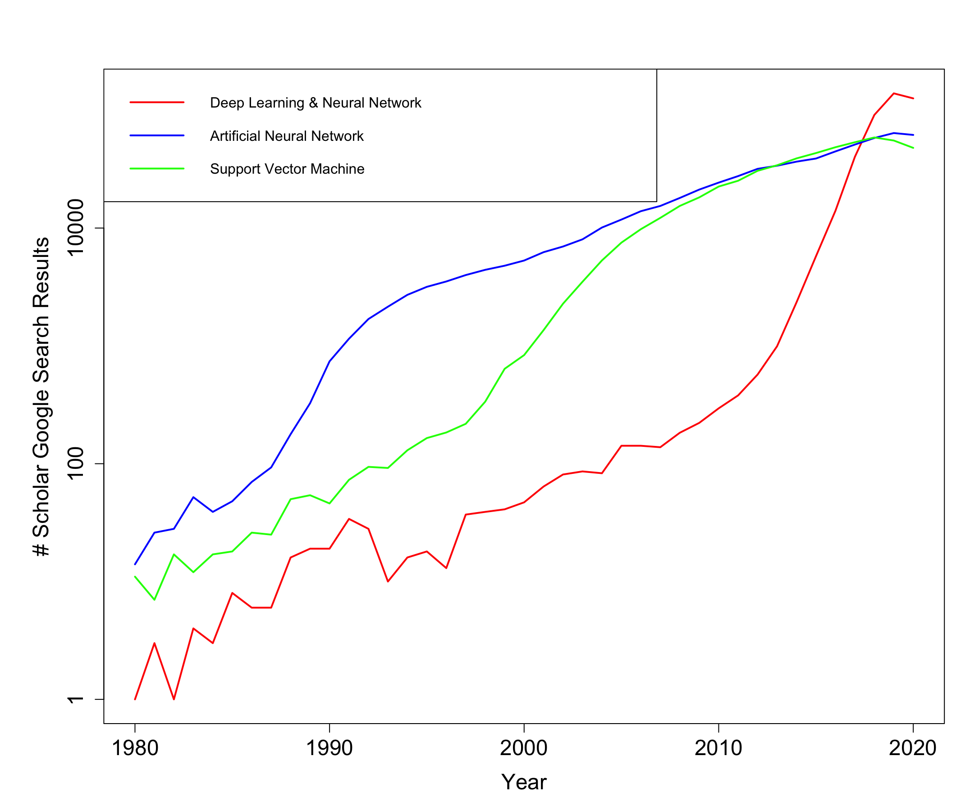
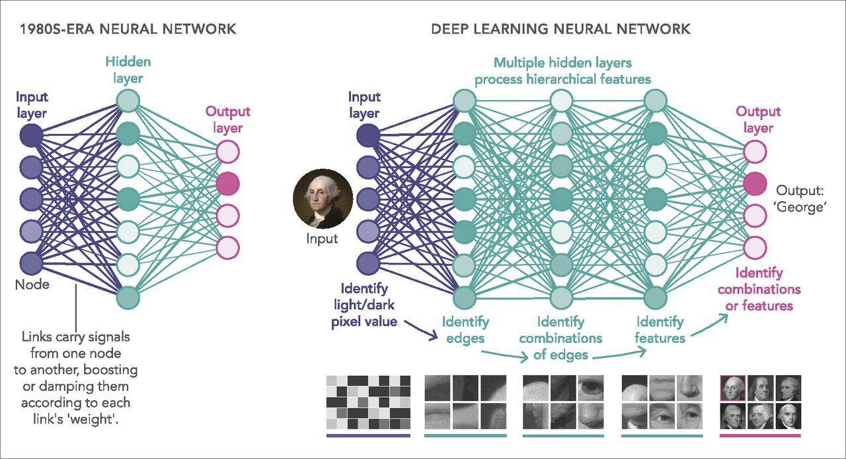
Deep learning citations
Markus Müller
Waldrop, PNAS 2019
Notes:
# search results without citation and patents

Slide 7
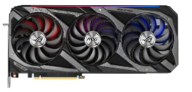
Early successes of DL
Markus Müller
‘Neural Computation & Adaptive Perception Program’ lead by G. Hinton, starts at CIFAR (2004)
DNNs outperform other approaches for
phone classification: DBN (Mohamed et al. NIPS, 2009) on TIMIT dataset @ CIFAR
image classification: ConvNet (AlexNet, Krizhevsky et al. NIPS, 2012) using GPUs, ReLU, dropout and data augmentation. Winner in ImageNet ILSVRC classification challenge (2012) @ CIFAR
language translation: RNN-LSTM (Sutskever et al. NIPS, 2014) @ Google
Training of DNNs on GPUs (since 2005), especially on NVIDIA GPUs with CUDA (after 2009) provided 10x speed-up (Raina et al, ICML, 2009)
Tensorflow (2015), PyTorch (2016), MxNet (2015), CTNK (2016)
…
‘ACM A. M. Turing Award’ for Geoffrey Hinten, Joshua Bengio and Yann LeCun (2018)
Notes:
CIFAR’s early leadership in AI was established as a result of the Learning in Machines & Brains program. In the 1980s, CIFAR launched a new AI research program called Artificial Intelligence, Robotics & Society, which included AI pioneer Geoffrey Hinton as one of its members. In 2004, he led the Neural Computation & Adaptive Perception Program, bringing computer and cognitive scientists together to develop a new approach to machine learning, inspired by the human brain. This program was renamed Learning in Machines & Brains in 2014. Under the co-direction of Yoshua Bengio and Yann LeCun, it continues to advance AI research.
Abdel-rahman Mohamed, George Dahl, and Geoffrey Hinton
Hidden Markov Models (HMMs) have been the state-of-the-art techniques for acoustic modeling despite their unrealistic independence assumptions and the very limited representational capacity of their hidden states. There are many proposals in the research community for deeper models that are capable of modeling the many types of variability present in the speech generation process. Deep Belief Networks (DBNs) have recently proved to be very effective for a variety of machine learning problems and this paper applies DBNs to acoustic modeling. On the standard TIMIT corpus, DBNs consistently outperform other techniques and the best DBN achieves a phone error rate (PER) of 23.0% on the TIMIT core test set.
AlexNet: Alex Krizhevsky Ilya Sutskever Geoffrey E. Hinton, University of Toronto
We trained a large, deep convolutional neural network to classify the 1.2 million high-resolution images in the ImageNet LSVRC-2010 contest into the 1000 dif- ferent classes. On the test data, we achieved top-1 and top-5 error rates of 37.5% and 17.0% which is considerably better than the previous state-of-the-art. The neural network, which has 60 million parameters and 650,000 neurons, consists of five convolutional layers, some of which are followed by max-pooling layers, and three fully-connected layers with a final 1000-way softmax. To make training faster, we used non-saturating neurons and a very efficient GPU implementation of the convolution operation. To reduce overfitting in the fully-connected layers we employed a recently-developed regularization method called “dropout” that proved to be very effective. We also entered a variant of this model in the ILSVRC-2012 competition and achieved a winning top-5 test error rate of 15.3%, compared to 26.2% achieved by the second-best entry.
Keras (François Chollet)
PyTorch Facebook
Tensorflow (Google Brain)
Theano (Univ Montreal)
CTNK (Microsoft)
MxNet (Apache)

Slide 8
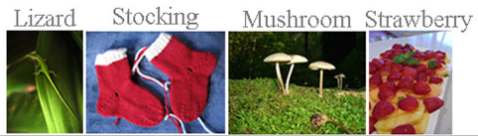
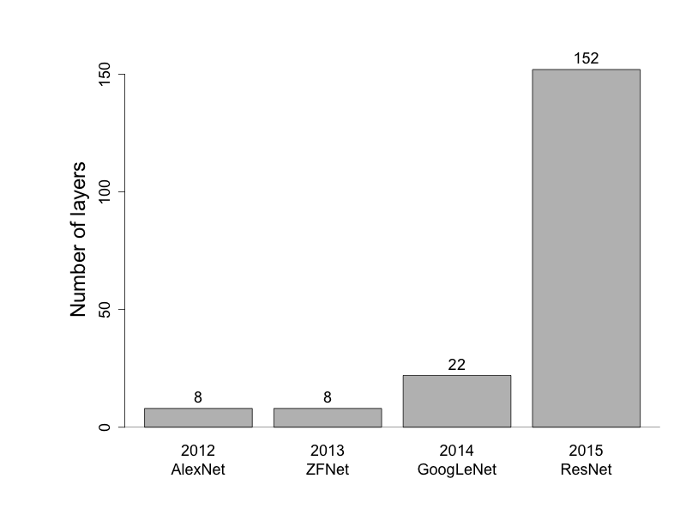
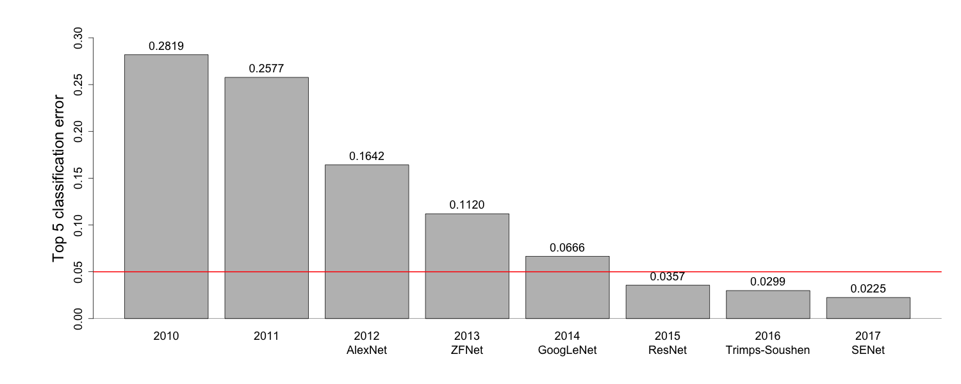
Going deep (ILSRVR challenge)
Markus Müller
1’200’000 images
1000 categories
Deep learning
62.3M parameters
Russakovsky et al., Int J Comput Vis 2015
https://www.image-net.org/
Notes:
AlexNet: Alex Krizhevsky Ilya Sutskever Geoffrey E. Hinton, University of Toronto
ZFNet: Zeiler & Fergus
GoogleLeNet: 22 layers including 9 inception layers
SENet: Squeeze-and-excitation network. Extends GoogLeNet and ResNet with attention-like blocks
ILSRVR ( ImageNet Large Scale Visual Recognition Challenge) database with currently 14,197,122 images. Limited to 1,000 fine-grained categories there are 1’200’000 images
Usually copped to 224x224 in RGB.
ILSVRC2010: 1’200’000 train, 50’000 validation, 150’000 test, 1000 categories
5 labels per image: I_j, j=1..5
True image labels: g_k, k=1..n
E = 1/n Sum_k min_j d(I_j, g_k)

Slide 9
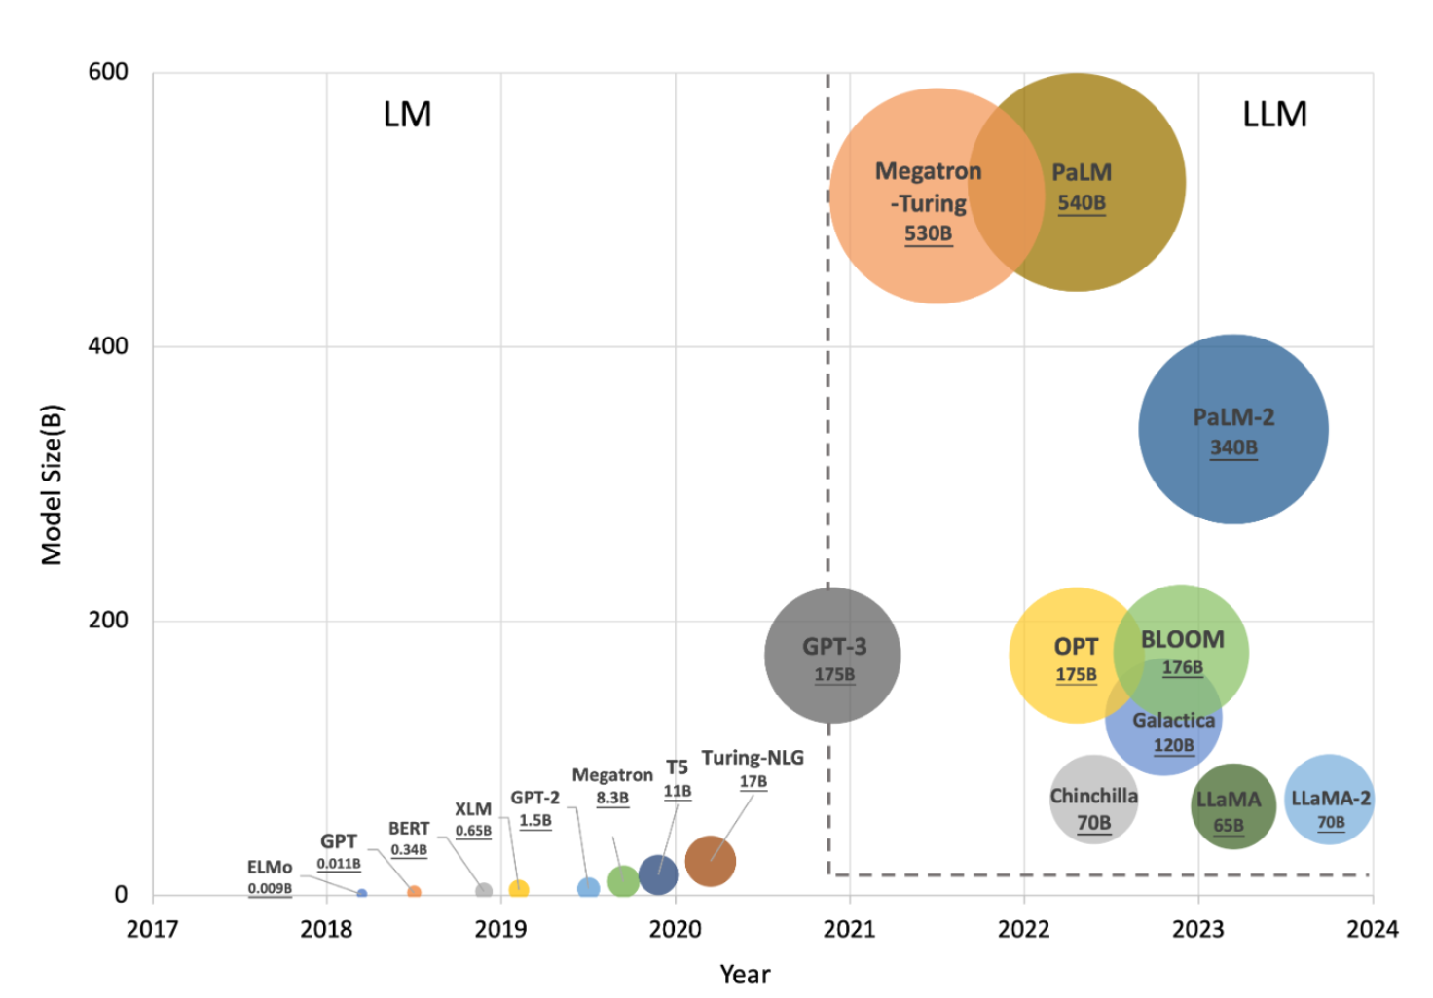
Going deeper (large language models LLMs)
Markus Müller
GPT-4 (OpenAI)
10¹² parameters
$100m for development
Running all Google searches with GPT-4: $6bn a year
More parameters not always lead to better performance
Parameters can be compressed without performance loss
Algorithms and chips can be improved
Adapting the models to more specialiced tasks needs much less parameters and training time
He et al. arXiv, 2023
Notes:
GPT training cost > $1bn by 2026
Volume of usable text documents to train exhausted

Slide 10
Deep learning success
Markus Müller
The success of DL in image, language, and sound processing is driven by the availability of large volumes of training data, an increase in computational power (e.g. GPUs).
Improvements in weight initialization, activation functions, gradient descent, batching of training data, dropout of neurons made learning robust and feasible for deep networks without the need for pretraining.
Improvement in the architecture of DNNs (convolution, skip connections, recurrency, attention)
Availability of easy-to-use DL frameworks such as Tensorflow or PyTorch
Notes:
Keras (François Chollet)
PyTorch Facebook
Tensorflow (Google Brain)
Theano (Univ Montreal)
CTNK (Microsoft)
MxNet (Apache)

Slide 11
Deep learning principles

Slide 12
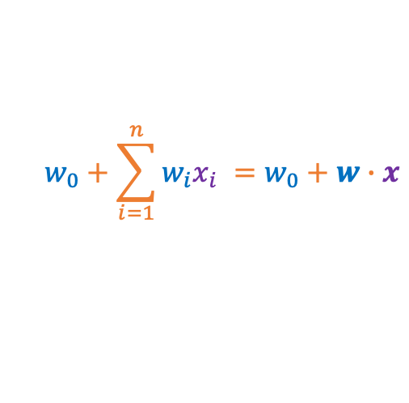

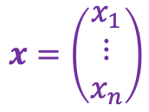
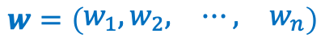
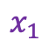


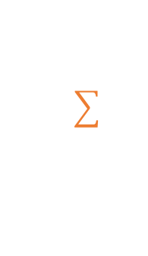
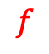
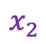
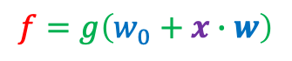

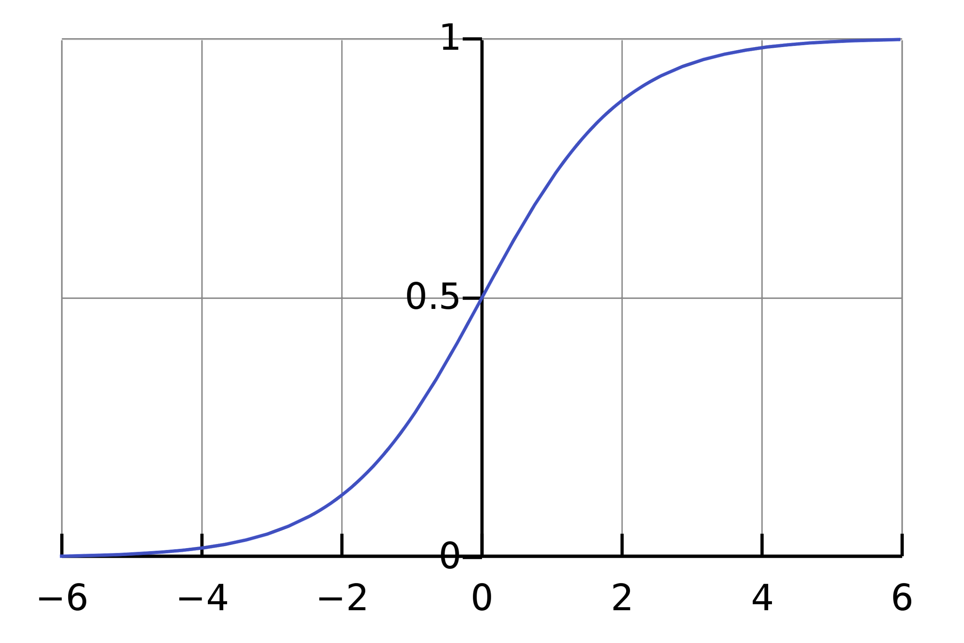
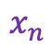
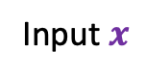
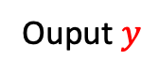
Single-layer perceptron
1

Slide 13


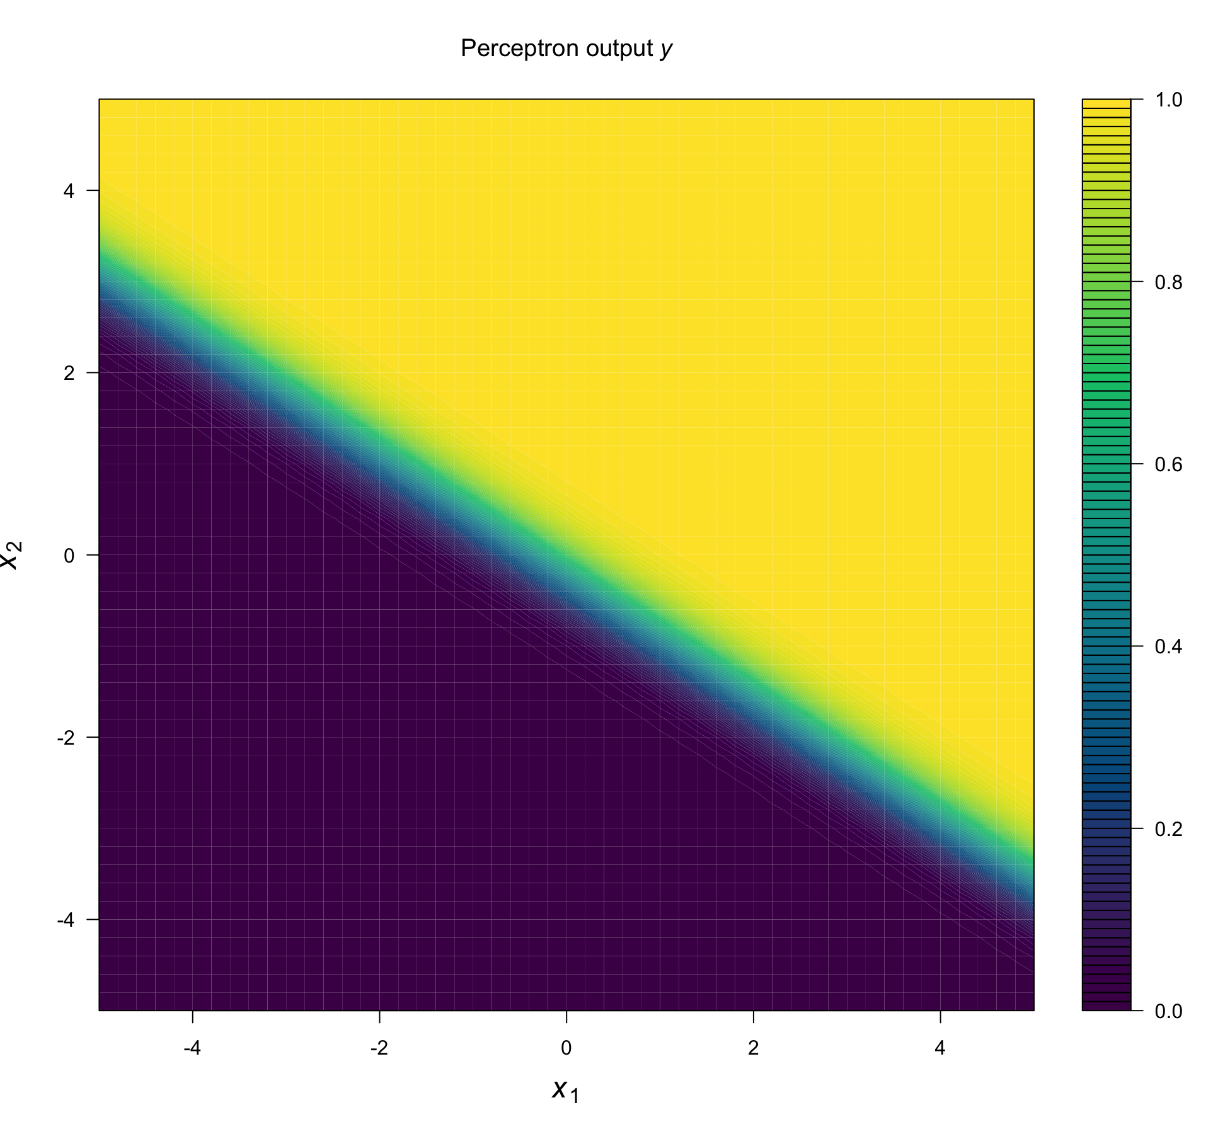
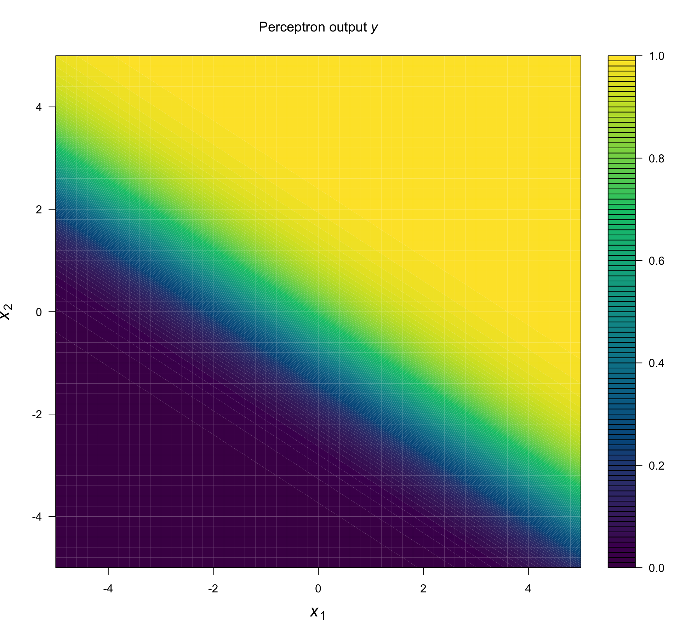
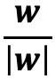
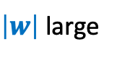

Markus Müller

Slide 14
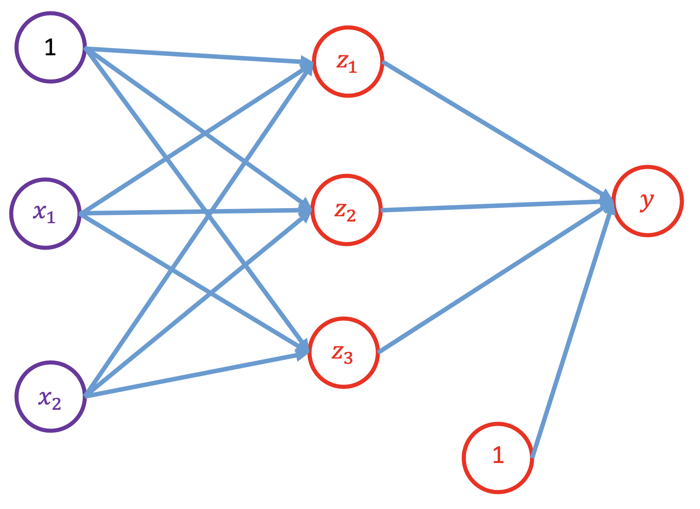
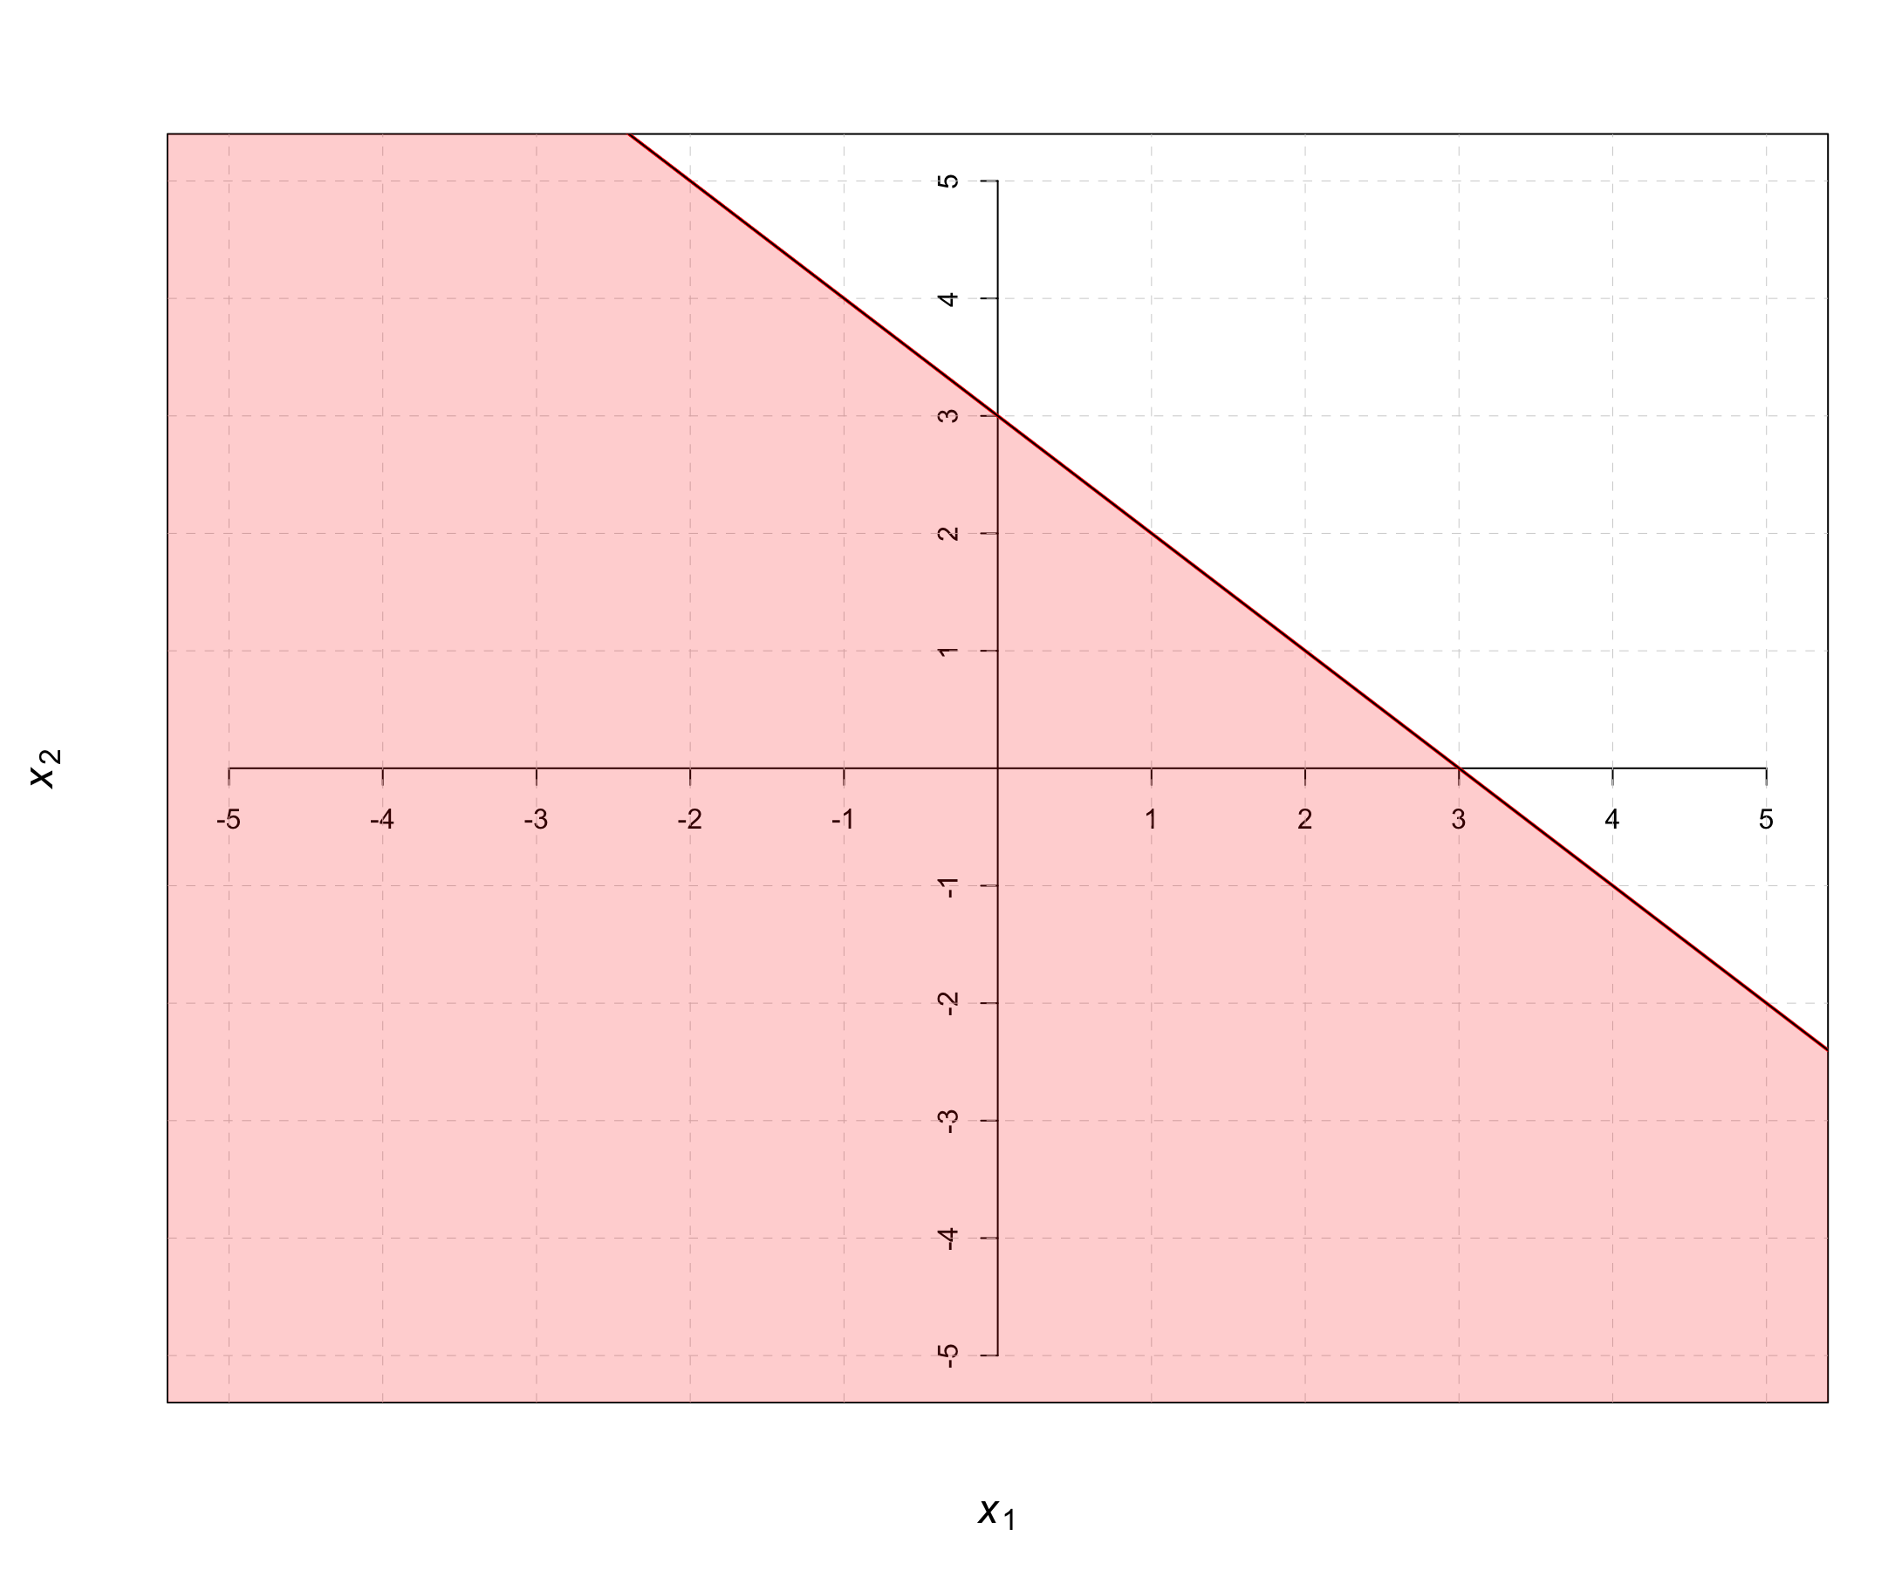
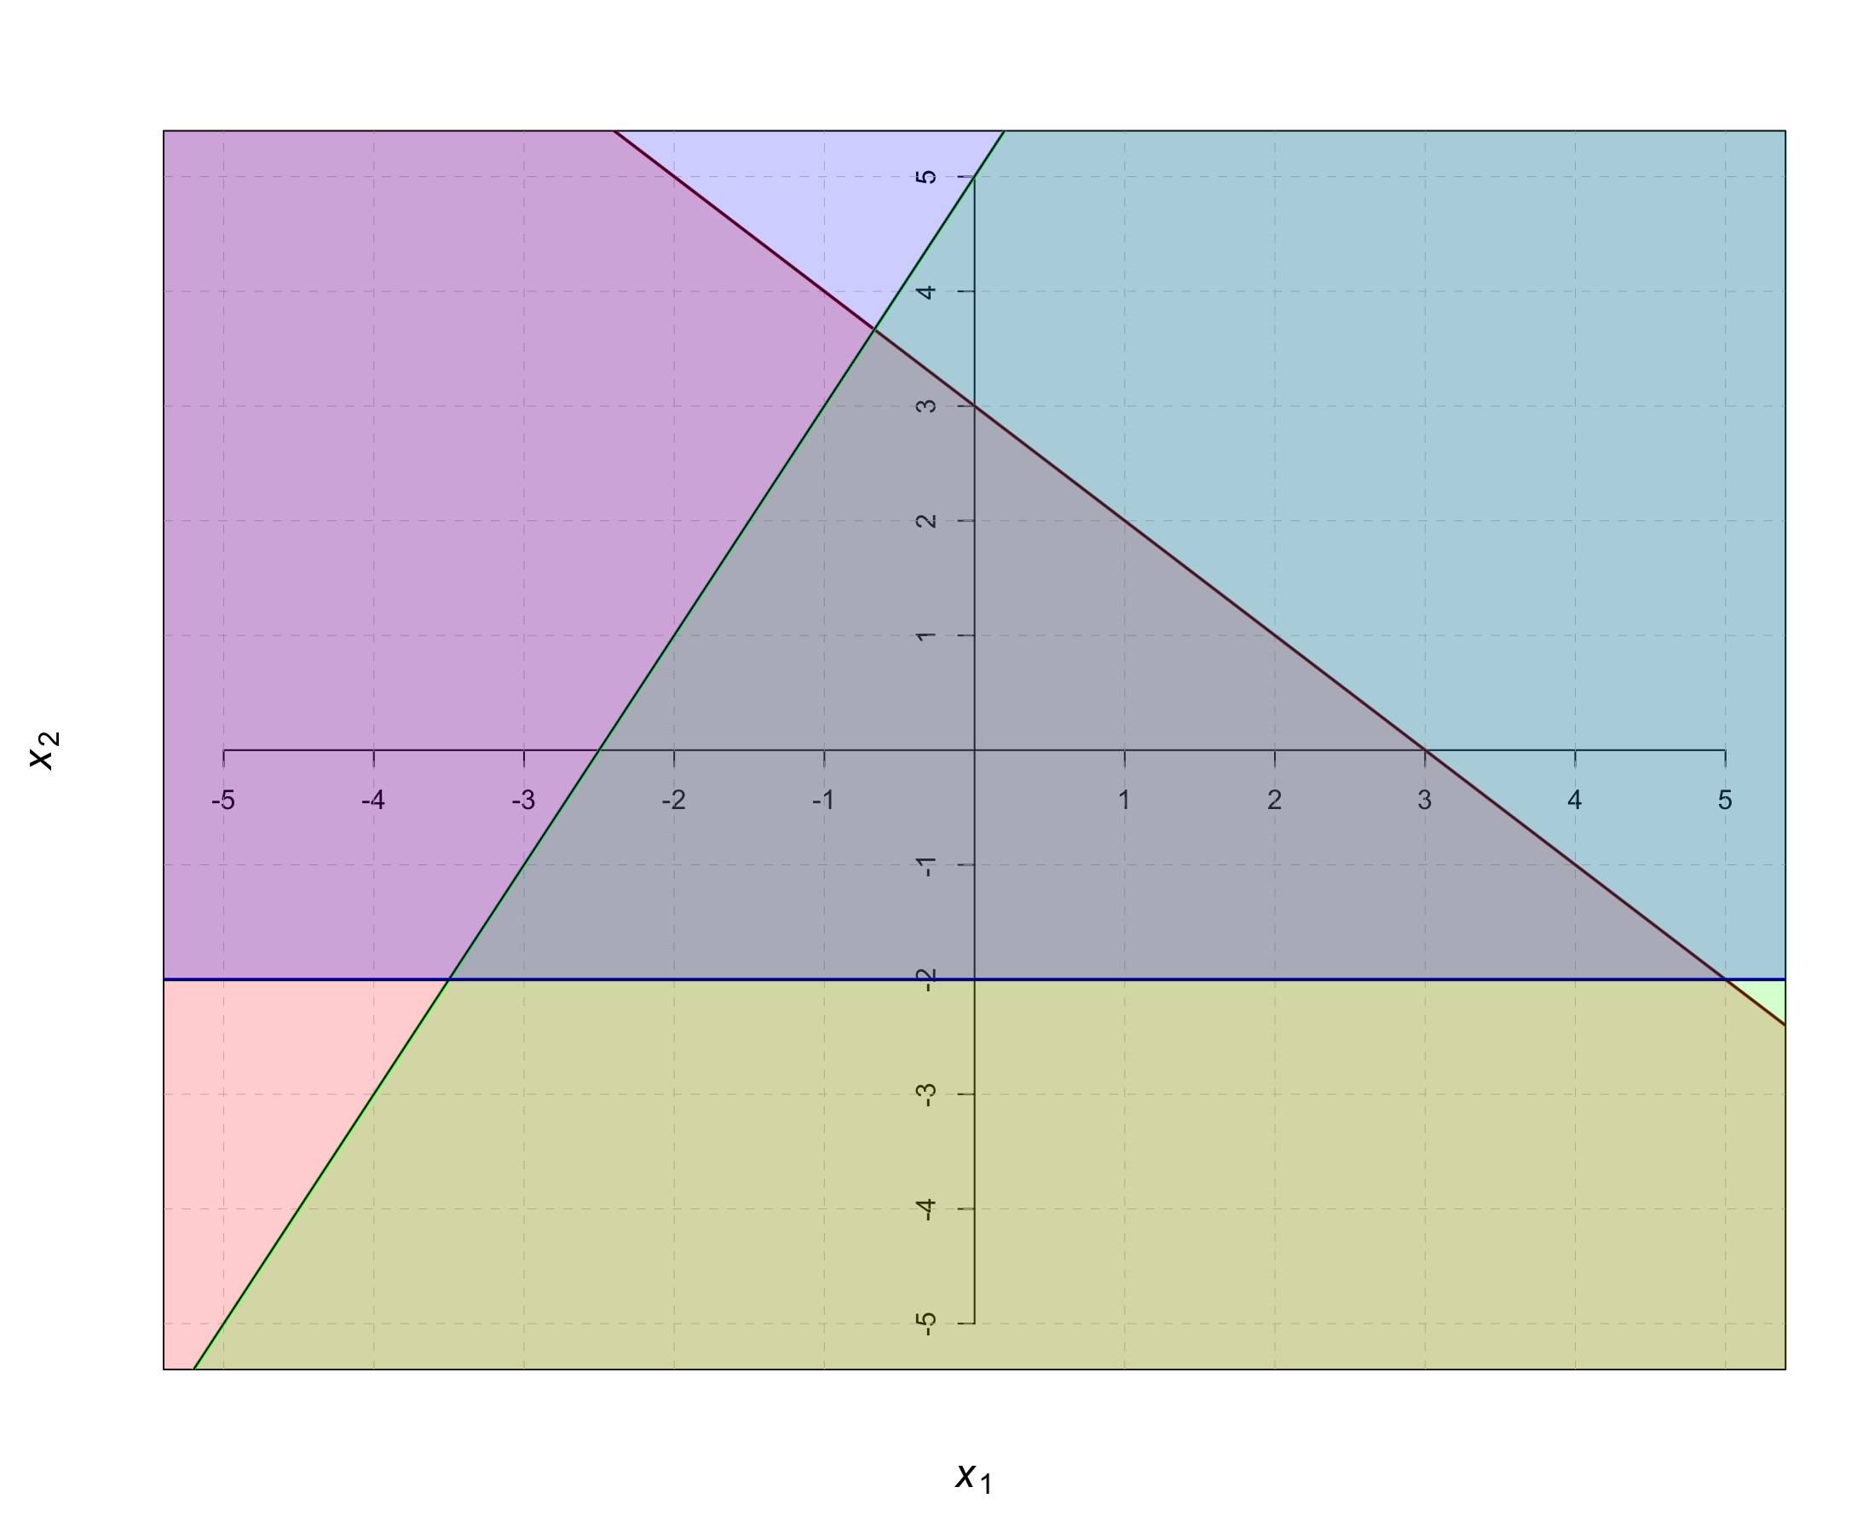
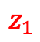
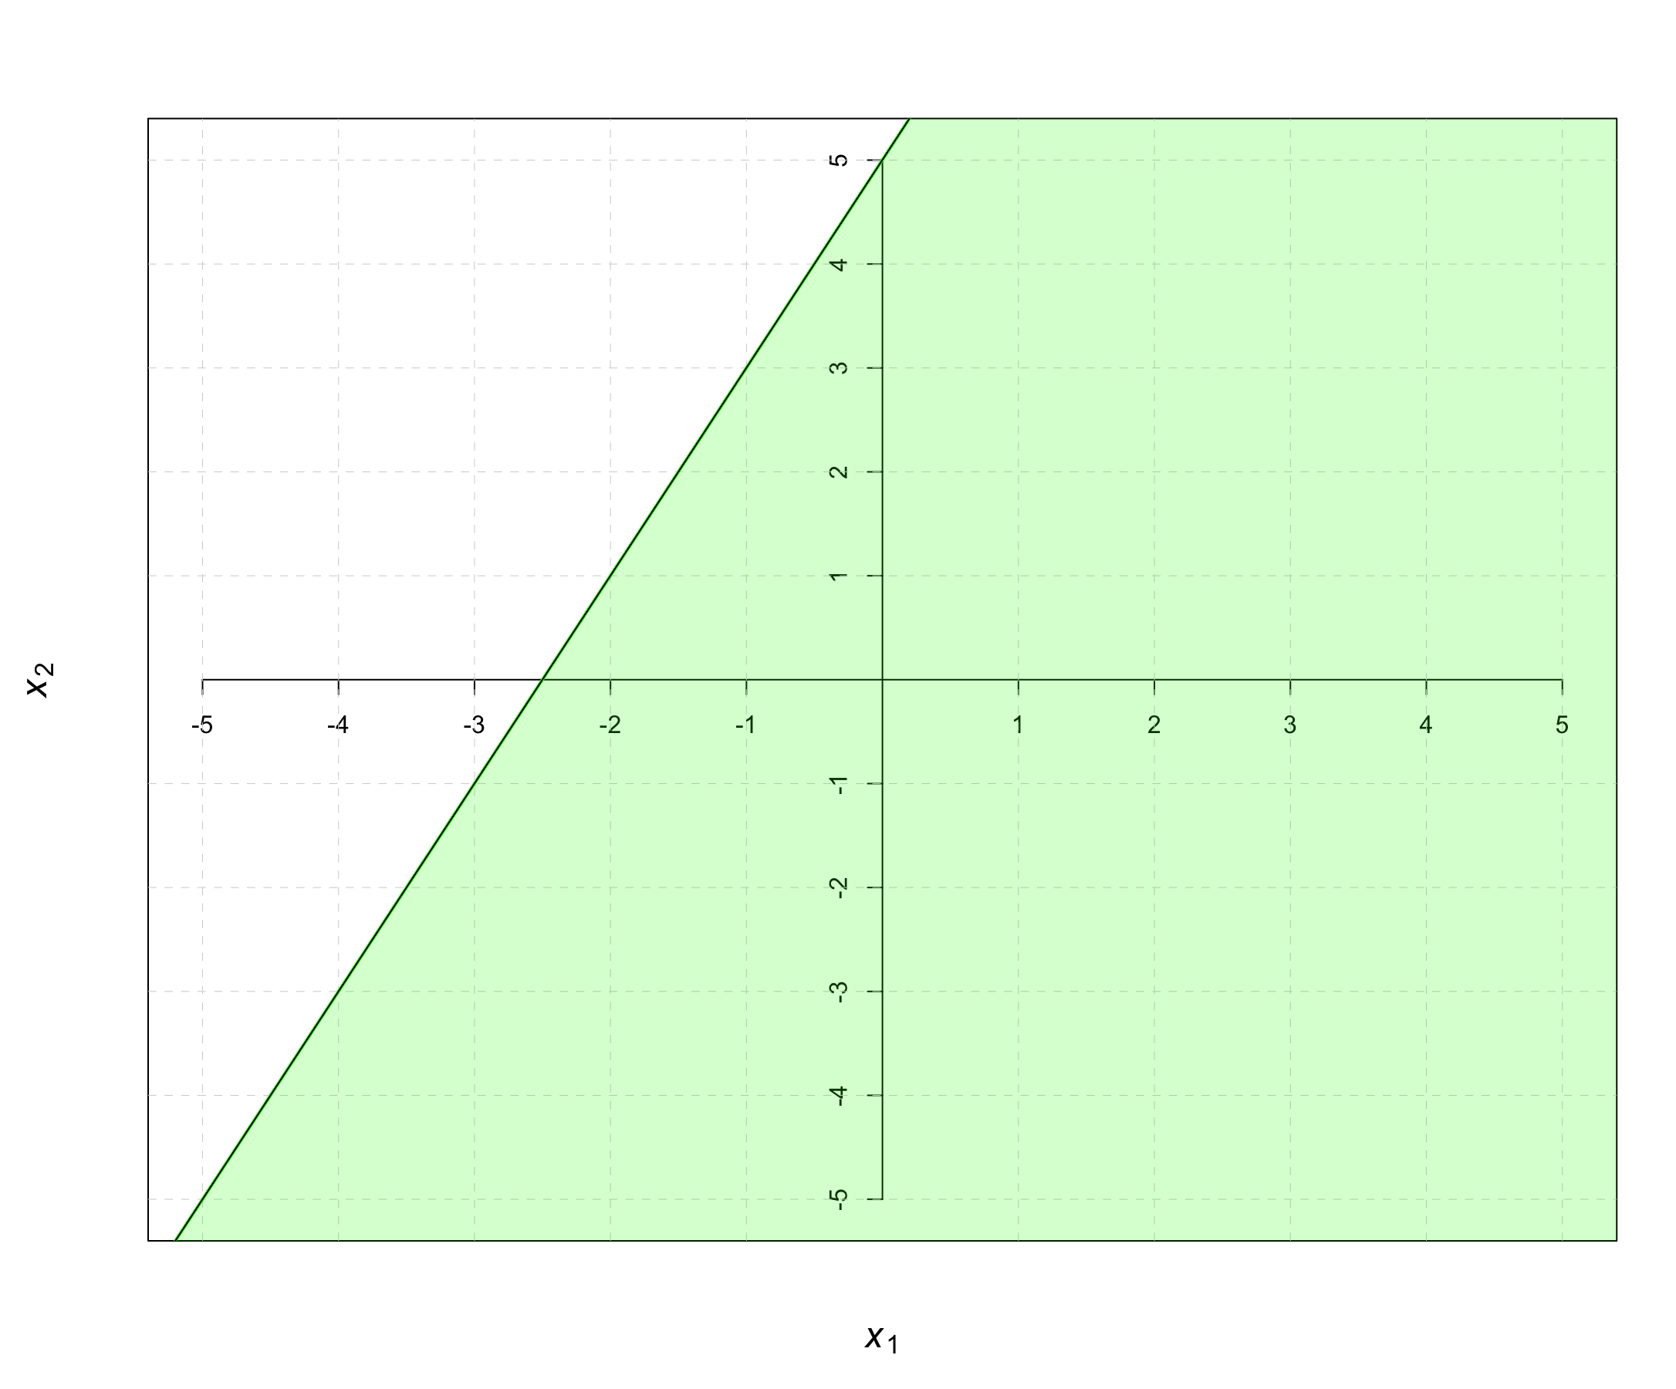
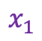
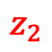
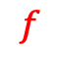
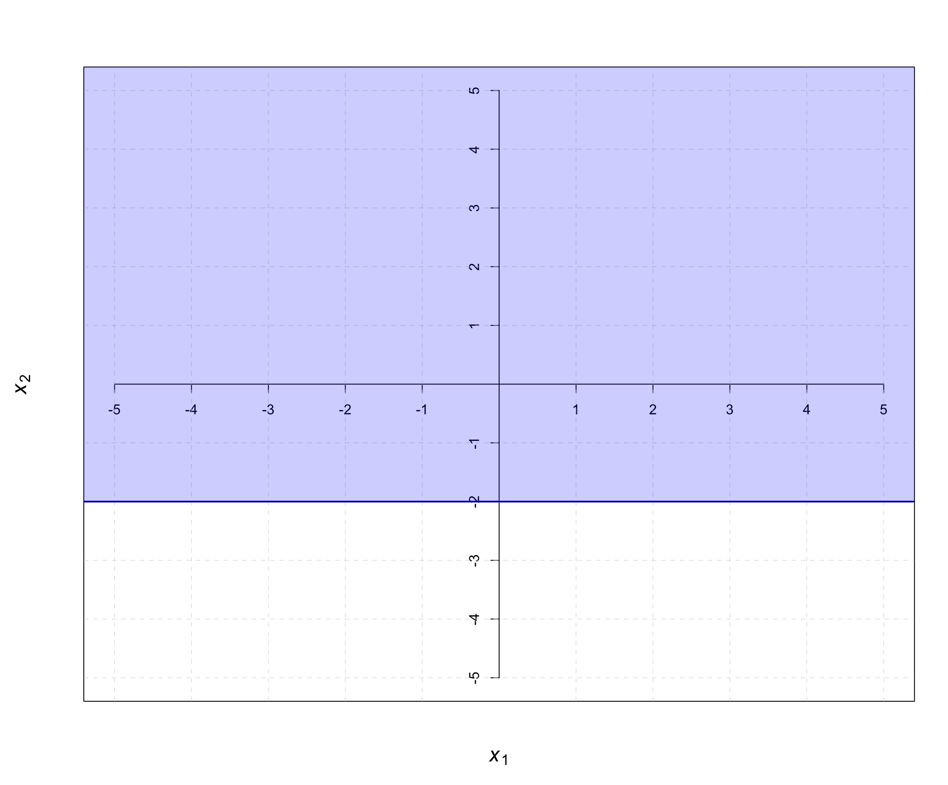
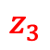
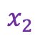
Multi-layer perceptron
1
0
0
0
1
2
2
1
3
3
1
-1
1
-1
1
2
5
0
-2.5
2
1
-1
1
2
1
0
1
-2.5
1
0
1
Notes:
At the basic level, a neuron does two things:
Receive input from other neurons and combine them together
Perform some kind of transformation to give the neuron’s output
In (1), we often take some linear combination of the inputs. In layman terms, if we had three inputs to the neuron (let’s call them x1, x2, and x3), then we would combine them like this:
This is a linear combination of inputs to our neurons where the individual blanks are parameters to be optimized for later (i.e. learn from the data what numbers best fill in those blanks). In mathematical terms, the blanks that are attached to the inputs (x1, x2 and x3) are called weights and the blank that is not attached to any input is called the bias.
With the linear combination, we apply some function (called the activation function) to achieve our eventual output. Common examples of these functions are:
Sigmoid Function (A function which ‘squeezes’ all the initial output to be between 0 and 1)
tanh Function (A function which ‘squeezes’ all the initial output to be between -1 and 1)
ReLU Function (If the initial output is negative, then output 0. If not, do nothing to the initial output)

Slide 15
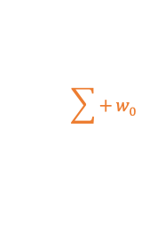
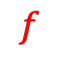
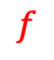
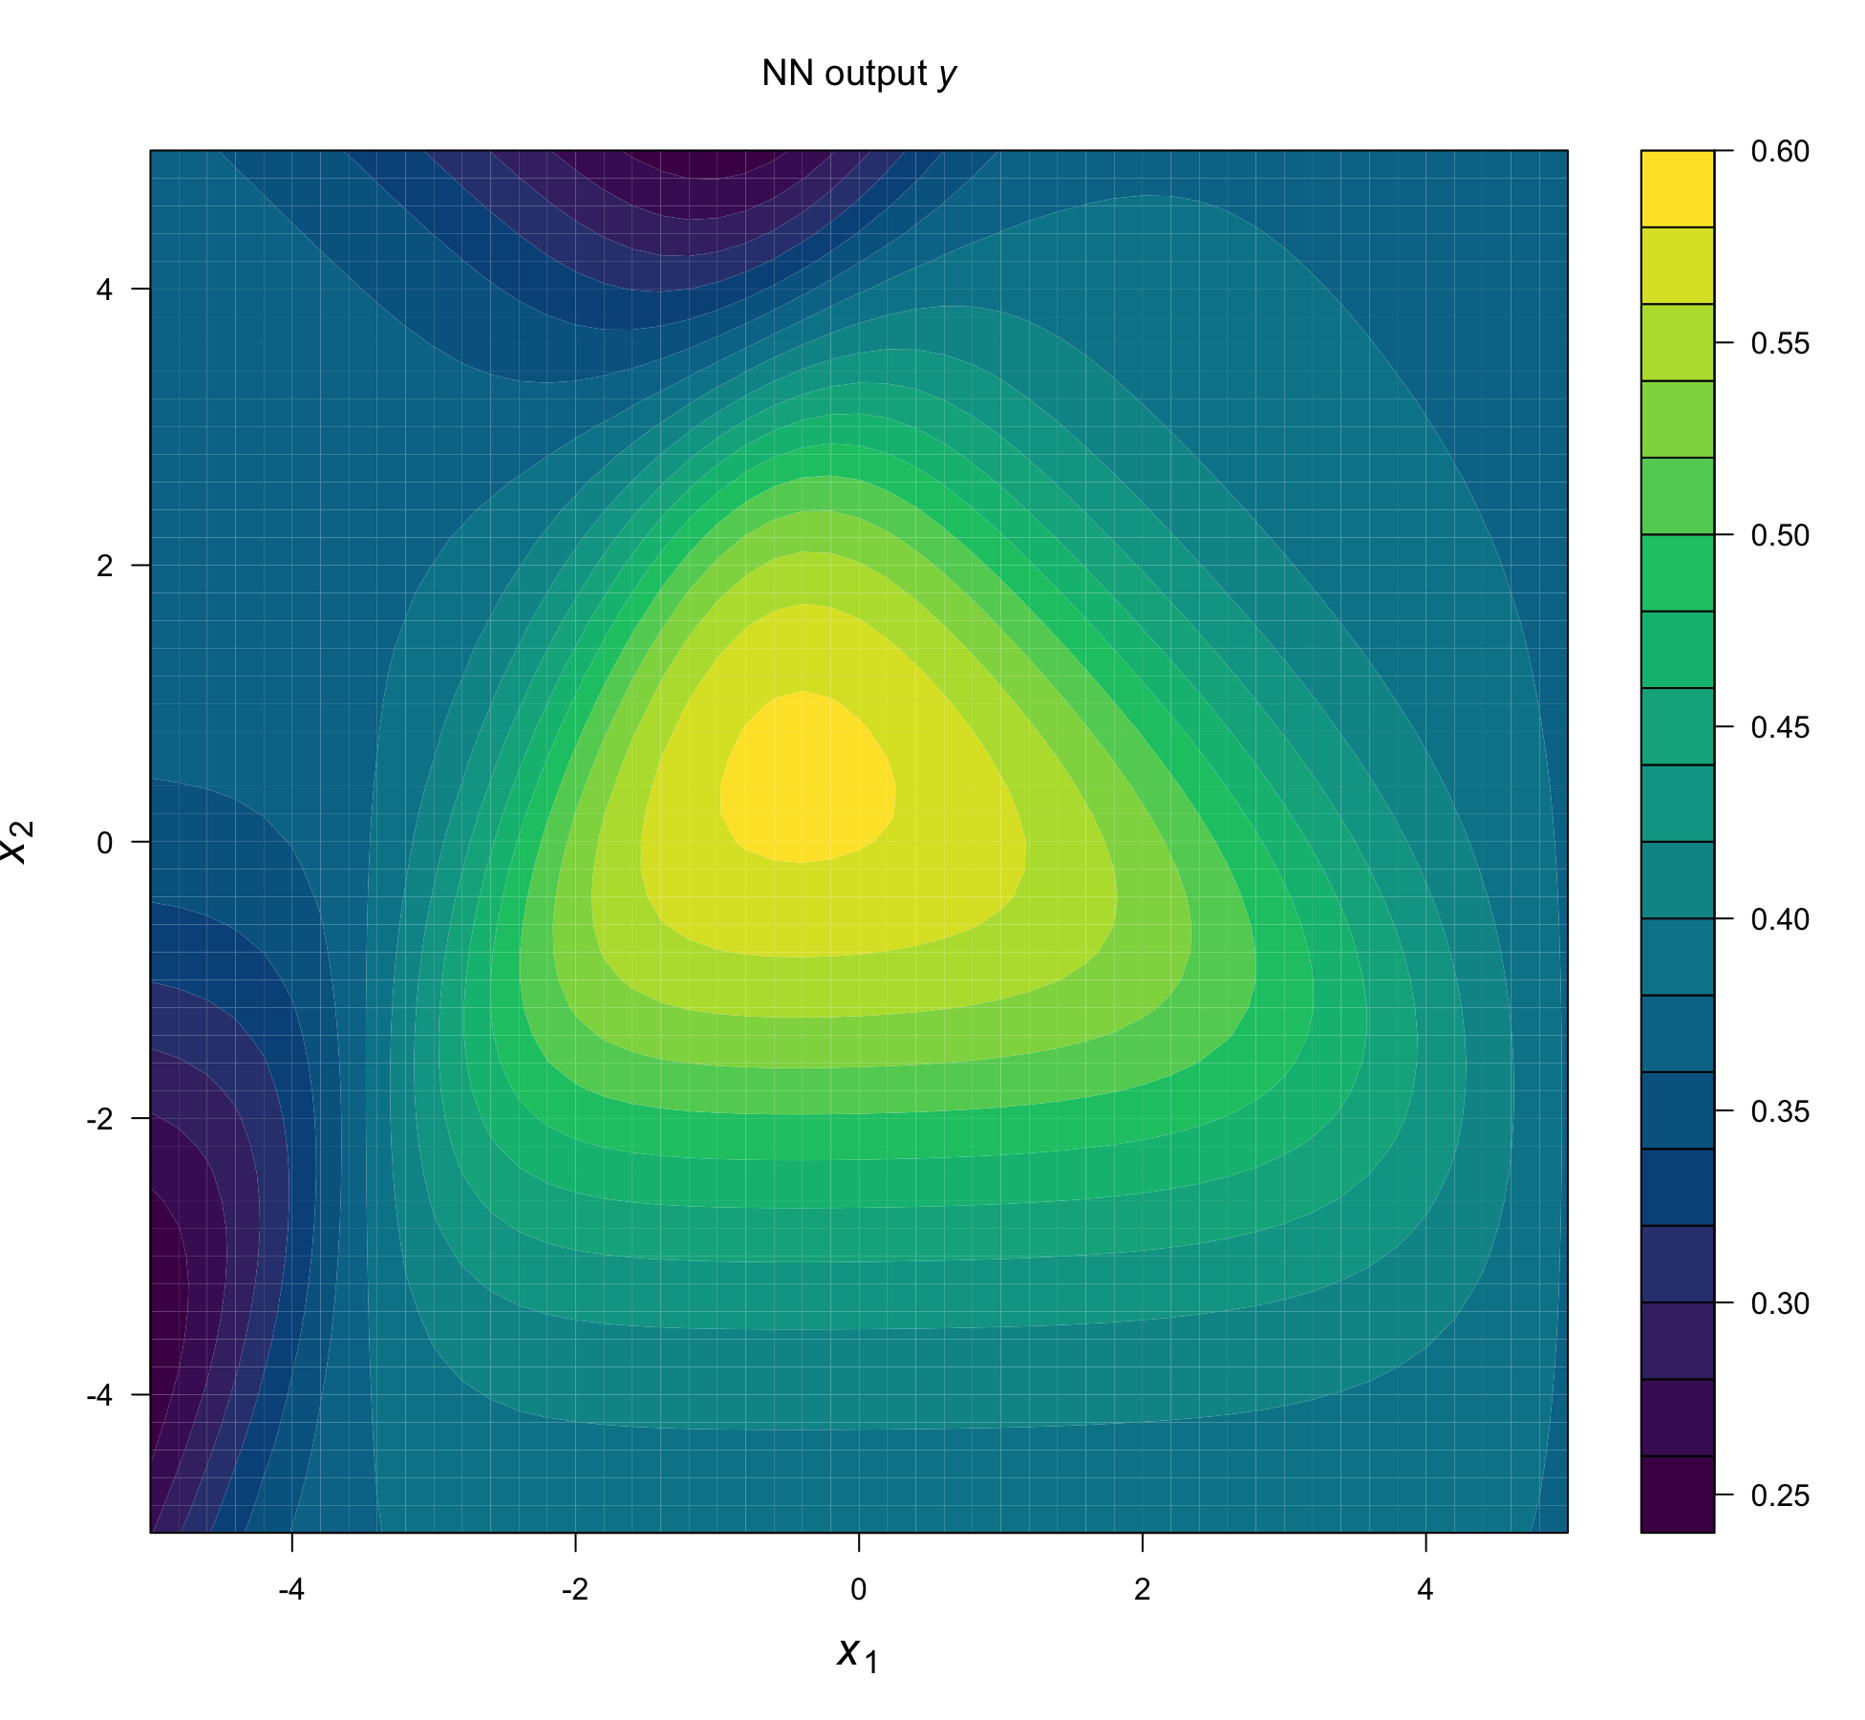
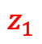
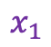
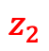
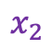
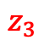
Multi-layer perceptron

Slide 16
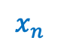
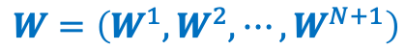













Multi-layer perceptrons (MLP) or deep neural networks (DNN)
Input layer
Output layer
Feature maps
Softmax for
classification
N Hidden layers
Notes:
At the basic level, a neuron does two things:
Receive input from other neurons and combine them together
Perform some kind of transformation to give the neuron’s output
In (1), we often take some linear combination of the inputs. In layman terms, if we had three inputs to the neuron (let’s call them x1, x2, and x3), then we would combine them like this:
This is a linear combination of inputs to our neurons where the individual blanks are parameters to be optimized for later (i.e. learn from the data what numbers best fill in those blanks). In mathematical terms, the blanks that are attached to the inputs (x1, x2 and x3) are called weights and the blank that is not attached to any input is called the bias.
With the linear combination, we apply some function (called the activation function) to achieve our eventual output. Common examples of these functions are:
Sigmoid Function (A function which ‘squeezes’ all the initial output to be between 0 and 1)
tanh Function (A function which ‘squeezes’ all the initial output to be between -1 and 1)
ReLU Function (If the initial output is negative, then output 0. If not, do nothing to the initial output)

Slide 17


Neural Net with 2 Internal Layers
1
0
0
1
Balestriero & Baraniuk, Proc IEEE, 2021
Notes:
At the basic level, a neuron does two things:
Receive input from other neurons and combine them together
Perform some kind of transformation to give the neuron’s output
In (1), we often take some linear combination of the inputs. In layman terms, if we had three inputs to the neuron (let’s call them x1, x2, and x3), then we would combine them like this:
This is a linear combination of inputs to our neurons where the individual blanks are parameters to be optimized for later (i.e. learn from the data what numbers best fill in those blanks). In mathematical terms, the blanks that are attached to the inputs (x1, x2 and x3) are called weights and the blank that is not attached to any input is called the bias.
With the linear combination, we apply some function (called the activation function) to achieve our eventual output. Common examples of these functions are:
Sigmoid Function (A function which ‘squeezes’ all the initial output to be between 0 and 1)
tanh Function (A function which ‘squeezes’ all the initial output to be between -1 and 1)
ReLU Function (If the initial output is negative, then output 0. If not, do nothing to the initial output)

Slide 18
Deep Neural Networks
It can be shown mathematically that single layer neural networks are able to approximate any function in N dimensions if there are enough neurons and one is able to find the correct weights (e.g. Cybenko, Math. Control Signals Syst., 1989, Hornik et al. Neural Networks, 1991)
However multilayer neural networks can perform this task much more efficiently (much less weights and training time) for hierarchical sparse functions (Mhaskar et al. 2017)
In a trained multilayer neural networks each layer is able to extract essential information from the previous layer and pass it on to the next layer. This provides a hierarchical decomposition of a big task into a sequel of smaller subtasks.
Notes:
Mhaskar et al:
We argue that the basic properties of locality at different scales and shift invariance in many natural signals such as images and text implies that many (but not all) tasks on such inputs can be solved by compositional algorithms. Of course, there are many signals or problems that cannot be solved by shift invariant, scalable algorithms. Thus for the many problems that are not compositional we do not expect any advantage of deep convolutional networks.
Deep architectures attempt to learn hierarchical structure, and hold the promise of being able to first learn simple concepts, and then successfully build up more complex concepts by composing together the simpler ones.
Compositionality by itself – defined just as a hierarchy of functions – cannot avoid the curse of dimensionality but locality in the hierarchy does as our theorems show. Thus : hierarchical locality is sufficient to avoid the curse of dimensionality.
>>>>>>
A study by van Hateren and van der Schaaf [8] showed that the filters learned by independent components analysis (ICA) [9] on natural image data match very well with the classical receptive fields of V1 simple cells. (Filters learned by sparse coding [10, 11] also similarly give responses similar to V1 simple cells.)
The receptive field of simple cells in V1 are localized, oriented, bandpass filters that resemble gabor filters.
These results are consistent with the “efficient coding hypothesis” which posits that the goal of early visual processing is to encode visual information as efficiently as possible [14]. Some hierarchical extensions of these models [15, 6, 16] are able to learn features that are more complex than simple oriented bars. For example, hierarchical sparse models of natural images have accounted for complex cell receptive fields [17], topography [18, 6], colinearity and contour coding [19]. Other models, such as [20], have also been shown to give V1 complex cell-like properties.

Slide 19

Deep Neural Networks

Slide 20


DNN as universal approximators
Inception v3, ConvNet 13 layers, 1649402 parameters
CIFAR10
Zhang et al. CACM, 2021
Notes:
Inception 1,649,402 parameters
Cifar10: 60’000 images 10 classes
aug is data augmentation; wd is weight decay; BN is batch normalization.
Same for AlexNet and MLP

Slide 21

















‘Classical’ ML
Deep Learning:
end-to-end
Engineered
features
Learned features 1
Learned features 2
Learned features 3
SVM
Classifier
Notes:
Deep. Learning = representation learning
Sparse coding
LeCun et al:
Conventional machine-learning techniques were limited in their ability to process natural data in their raw form. For decades, con- structing a pattern-recognition or machine-learning system required careful engineering and considerable domain expertise to design a feature extractor that transformed the raw data.
Deep-learning methods are representation-learning methods with multiple levels of representation, obtained by composing simple but non-linear modules that each transform the representation at one level (starting with the raw input) into a representation at a higher, slightly more abstract level.
An image, for example, comes in the form of an array of pixel values, and the learned features in the first layer of representation typically represent the presence or absence of edges at particular orientations and locations in the image. The second layer typically detects motifs by spotting particular arrangements of edges, regardless of small variations in the edge positions. The third layer may assemble motifs into larger combinations that correspond to parts of familiar objects, and subsequent layers would detect objects as combinations of these parts. The key aspect of deep learning is that these layers of features are not designed by human engineers: they are learned from data using a general-purpose learning procedure.
Each module in the stack transforms its input to increase both the selectivity and the invariance of the representation. With multiple non-linear layers, say a depth of 5 to 20, a system can implement extremely intricate func- tions of its inputs that are simultaneously sensitive to minute details — distinguishing Samoyeds from white wolves — and insensitive to large irrelevant variations such as the background, pose, lighting and surrounding objects.
For smaller data sets, unsupervised pre-training helps to prevent overfitting leading to significantly better generalization when the number of labelled exam- ples is small, or in a transfer setting where we have lots of examples for some ‘source’ tasks but very few for some ‘target’ tasks. Once deep learning had been rehabilitated, it turned out that the pre-training stage was only needed for small data sets.
The hidden layers of a multilayer neural network learn to repre- sent the network’s inputs in a way that makes it easy to predict the target outputs.

Slide 22











Distributed Representations of Names and Relations
Markus Müller
Feature maps
1 2 3 4 5 6
24 Names
12 Relations
Rumelhart et al. Nature 1986
Notes:
Distributed representations of words in a vector space help learning algorithms to achieve better performance in natural language processing tasks by grouping similar words. One of the earliest use of word representations dates back to 1986 due to Rumelhart, Hinton, and Williams
The word representations computed using neural networks are very interesting because the learned vectors explicitly encode many linguistic regularities and patterns. Somewhat surprisingly, many of these patterns can be represented as linear translations. For example, the result of a vector calcula- tion vec(“Madrid”) - vec(“Spain”) + vec(“France”) is closer to vec(“Paris”) than to any other word vector [9, 8].

Slide 23












Representations in ConvNets
Markus Müller
Layer 3
Layer 1
Layer 4
Layer 2
Layer 5
Zeiler & Fergus, ECCV, 2014
Top 9 activations by test images of randomly selected feature maps in 8 layer AlexNet projected back to image space by DeconvNet together with validation set image patches that cause the activation.
Notes:
To examine a given convnet (Le-net or AlexNet) activation, we set all other activations in the layer to zero and pass the feature maps as input to the attached deconvnet layer. Then we successively (i) unpool, (ii) rectify and (iii) filter to reconstruct the activity in the layer beneath that gave rise to the chosen activation. This is then repeated until input pixel space is reached.
When trained on natural images, the layers of our model capture image information in a variety of forms: low-level edges, mid-level edge junctions, high-level object parts and complete objects.
Visualization of features in a fully trained model. For layers 2-5 we show the top 9 activations in a random subset of feature maps across the validation data, projected down to pixel space using our deconvolutional network approach. Our reconstructions are not samples from the model: they are reconstructed patterns from the validation set that cause high activations in a given feature map. For each feature map we also show the corresponding image patches. Note: (i) the the strong grouping within each feature map, (ii) greater invariance at higher layers and (iii) exaggeration of discriminative parts of the image, e.g. eyes and noses of dogs (layer 4, row 1, cols 1).
Fig. 2 shows feature visualizations from our model once training is complete. For a given feature map, we show
the top 9 activations, each projected separately down to pixel space, revealing the different structures that excite
that map and showing its invariance to input deformations. Alongside these visualizations we show the
corresponding image patches.
Visualization of features in a fully trained model. For layers 2-5 we show the top 9 activations in a random subset of feature maps across the validation data, projected down to pixel space using our deconvolutional network approach. Our reconstructions are not samples from the model: they are reconstructed patterns from the validation set that cause high activations in a given feature map. For each feature map we also show the corresponding image patches. Note: (i) the the strong grouping within each feature map, (ii) greater invariance at higher layers and (iii) exaggeration of discriminative parts of the image, e.g. eyes and noses of dogs (layer 4, row 1, cols 1). Best viewed in electronic form. The compression artifacts are a consequence of the 30Mb submission limit, not the reconstruction algorithm itself.
The lower layers of the model can be seen to converge within a few epochs. However, the upper layers only develop develop after a considerable number of epochs (40-50), demonstrating the need to let the models train until fully converged.

Slide 24






Word embeddings
How to get smarter
word representations?
“the dog barks”
one-hot-encoding
word embedding space
word2vec: Mikolov et al. , 2013
the
the
dog
orthogonal
equidistant
a
barks
miaows
Bengio et al. 2003
barks
dog
Word2Vec Colab
moon
cat
neighboring word pairs as training data D &
negative examples D’
1-layer NN
the, dog; D
dog, the; D
dog, barks; D
barks, dog; D
dog, moon; D’
barks, juice; D’
The training objective is to learn word vector representations that bring the nearby words close
together and random words far apart.
Notes:
Word2vec from Google
Vector length 50-300
Each word in the context is presented to the network as a one-of-N vector, that is, one component has a value of 1 and the rest are 0. In the first layer, each word creates a different pattern of activations, or word vectors predict the next word in a sequence from a local context of earlier words.
In a language model, the other layers of the network learn to convert the input word vectors into an output word vector for the predicted next word, which can be used to predict the probability for any word in the vocabulary to appear as the next word. The network learns word vectors that contain many active components each of which can be interpreted as a separate feature of the word, as was first demonstrated27 in the context of learning distributed representations for symbols. These semantic features were not explicitly present in the input. They were discovered by the learning procedure as a good way of factorizing the structured relationships between the input and output symbols into multiple ‘micro-rules’.
The issue of representation lies at the heart of the debate between the logic-inspired and the neural-network-inspired paradigms for cognition. In the logic-inspired paradigm, an instance of a symbol is something for which the only property is that it is either identical or non-identical to other symbol instances. It has no internal structure that is relevant to its use; and to reason with symbols, they must be bound to the variables in judiciously chosen rules of inference. By contrast, neural networks just use big activity vectors, big weight matrices and scalar non-linearities to perform the type of fast ‘intuitive’ inference that underpins effortless commonsense reasoning.
neural language models can because they associate each word with a vector of real valued features, and semantically related words end up close to each other in that vector space
Finally, we describe another interesting property of the Skip-gram model. We found that simple vector addition can often produce meaningful results. For example, vec(“Russia”) + vec(“river”) is close to vec(“Volga River”), and vec(“Germany”) + vec(“capital”) is close to vec(“Berlin”). This compositionality suggests that a non-obvious degree of language understanding can be obtained by using basic mathematical operations on the word vector representations.

Slide 25

Word embeddings
Lisbon ~ Warsaw - Poland + Portugal
The dog walks in the park ~ A cat creeps around the field
Mikolov et al. , 2013
Notes:
Word2vec from Google
Vector length 50-300
Each word in the context is presented to the network as a one-of-N vector, that is, one component has a value of 1 and the rest are 0. In the first layer, each word creates a different pattern of activations, or word vectors predict the next word in a sequence from a local context of earlier words.
In a language model, the other layers of the network learn to convert the input word vectors into an output word vector for the predicted next word, which can be used to predict the probability for any word in the vocabulary to appear as the next word. The network learns word vectors that contain many active components each of which can be interpreted as a separate feature of the word, as was first demonstrated27 in the context of learning distributed representations for symbols. These semantic features were not explicitly present in the input. They were discovered by the learning procedure as a good way of factorizing the structured relationships between the input and output symbols into multiple ‘micro-rules’.
The issue of representation lies at the heart of the debate between the logic-inspired and the neural-network-inspired paradigms for cognition. In the logic-inspired paradigm, an instance of a symbol is something for which the only property is that it is either identical or non-identical to other symbol instances. It has no internal structure that is relevant to its use; and to reason with symbols, they must be bound to the variables in judiciously chosen rules of inference. By contrast, neural networks just use big activity vectors, big weight matrices and scalar non-linearities to perform the type of fast ‘intuitive’ inference that underpins effortless commonsense reasoning.
neural language models can because they associate each word with a vector of real valued features, and semantically related words end up close to each other in that vector space
Finally, we describe another interesting property of the Skip-gram model. We found that simple vector addition can often produce meaningful results. For example, vec(“Russia”) + vec(“river”) is close to vec(“Volga River”), and vec(“Germany”) + vec(“capital”) is close to vec(“Berlin”). This compositionality suggests that a non-obvious degree of language understanding can be obtained by using basic mathematical operations on the word vector representations.

Slide 26


Protein Sequence Embeddings
Alley et al., Nat. Methods, 2019
Notes:
Alley et al:
Here, we use a recurrent neural network (RNN) to learn statistical representations of proteins from ~24 million UniRef50 (ref. ²²) sequences (Fig. 1a). Without structural or evolutionary data, this unified representation (UniRep) summarizes arbitrary protein sequences into fixed-length vectors approximating fundamental protein features (Fig. 1b). This method scalably leverages underused raw sequences to alleviate the data scarcity constraining protein informatics so far, and achieves generalizable, superior performance in critical engineering tasks from stability, to function, to design.
Amino acid one-hot encoding converted to amino acid embeddings
This architecture learns by going through a sequence of characters in order, trying to predict the next one based on the model’s dynamic internal ‘summary’ of the sequence it has seen so far (its ‘hidden state’). During training, the model gradually revises the way it constructs its hidden state to maximize the accuracy of its predictions, resulting in a progressively better statistical summary, or representation, of the sequence.

Slide 27


Encoder-decoders, autoencoders
Hinton & Salakhutdinov, Science, 2006

Slide 28
DNN training and configuration

Slide 29
Number of hidden layers and neurons MLP
Markus Müller
Start with one layer and add layer until overfitting becomes obvious or no more performance gains.
For MLPs the number of neurons in the hidden layers is usually the same for all layers. Sometimes the first layer is a bit bigger. Keep the number of neurons in the first layer larger than the input size.
Instead of trying to find the optimal numbers of layers and neurons it is better to choose a network that is a bit too large, and then use regularization during training to shrink it down to the right size (stretch pants approach)
Trainability of DNN depends on network design

Slide 30

Training data size and model complexity
Hestness et al., arXiv, 2017
Notes:
5 known variants of ResNets with depths 18, 34, 50, 101, and 152 layers.
We train and validate ResNets on various shard sizes of ImageNet, ranging from 1 image per class (0.08% of images) up to 800 images per class (62%). ImageNet has 1,000 different object classes as outputs.
For small training sets—less than roughly 25 images per class—these error metrics are roughly equal to the model random guessing (i.e., greater than −log(1/1, 000) ≈ 6.9 for cross-entropy, and near 1 − (1/1, 000) = 99.9% classification error.
Finally, Figure 4 also shows that model size growth is again predictable. The best-fit ResNet models grow following a sublinear curve with exponent βp = 0.573. This exponent indicates that they grow more slowly than models in other domains we have tested. However, even on the smallest data sets, ResNets require fairly large models to fit data well, at least 3.4M parameters.
Although different applications yield different power-law exponents and intercepts, these learning curves exist across a broad range of models, optimizers, regularizers, and loss functions. Improved model architectures and optimizers can improve the power-law intercept, but not the exponent; models for a single domain show the same learning curve steepness.
Finally, we find that models transition from a small training set region dominated by best guessing to a region dominated by power-law scaling. With sufficiently large training sets, models will saturate in a region dominated by irreducible error (e.g., Bayes error).
Most of these works show powerlaw generalization error scaling (ε(m) ∼ αm^β ) with exponent β = −0.5 or −1.

Slide 31



Supervised training of DNN
All weights and offsets from all layers

Slide 32







Loss or cost functions
Empirical loss:
Square loss:
regression
Cross entropy loss:
Classification K classes
Notes:
Do not mistake likelhood f_k for model confidence

Slide 33


Loss landscape
Notes:
Cooper:
Abstract. We explore some mathematical features of the loss landscape of overparameterized neural networks. A priori one might imagine that the loss function looks like a typical function from Rn to R - in particular, nonconvex, with discrete global minima. In this paper, we prove that in at least one important way, the loss function of an overparameterized neural network does not look like a typical function. If a neural net has n parameters and is trained on d data points, with n > d, we show that the locus M of global minima of L is usually not discrete, but rather an n − d dimensional submanifold of Rn. In practice, neural nets commonly have orders of magnitude more parameters than data points, so this observation implies that M is typically a very high-dimensional subset of Rn.
Training neural networks requires minimizing a high-dimensional non-convex loss function – a task that is hard in theory, but sometimes easy in practice. Despite the NP-hardness of training general neural loss functions [2], simple gradient methods often find global minimizers (parameter configurations with zero or near-zero training loss), even when data and labels are randomized before training [42]. However, this good behavior is not universal; the trainability of neural nets is highly dependent on network architecture design choices, the choice of optimizer, variable initialization, and a variety of other considerations
Recent theoretical and empirical results strongly suggest that local minima are not a serious issue in general. Instead, the landscape is packed with a combinatorially large number of saddle points where the gradient is zero, and the surface curves up in most dimensions and curves down in the reminder
Despite their overwhelming capacity to overfit, deep learning architectures tend to generalize rel- atively well to unseen data, allowing them to be deployed in practice.
One standing hypothesis that is gaining popularity, e.g. Hochreiter & Schmidhuber (1997); Keskar et al. (2017), is that the flatness of minima of the loss function found by stochastic gradient based methods results in good generalization. This pa- per argues that most notions of flatness are prob- lematic for deep models and can not be directly applied to explain generalization. Specifically, when focusing on deep networks with rectifier units, we can exploit the particular geometry of pa- rameter space induced by the inherent symmetries that these architectures exhibit to build equivalent models corresponding to arbitrarily sharper min- ima. Furthermore, if we allow to reparametrize a function, the geometry of its parameters can change drastically without affecting its generalization properties (Dinh et al.)
Baldassi et al:
In this paper we study basic nonconvex 1- and 2-layer neural net- work models that learn random patterns and derive a number of basic geometrical and algorithmic features which suggest some answers. We first show that the error loss function presents few extremely wide flat minima (WFM) which coexist with narrower minima and critical points. We then show that the minimizers of the cross-entropy loss function overlap with the WFM of the error loss. We also show examples of learning devices for which WFM do not exist. From the algorithmic perspective we derive entropy- driven greedy and message-passing algorithms that focus their search on wide flat regions of minimizers. In the case of SGD and cross-entropy loss, we show that a slow reduction of the norm of the weights along the learning process also leads to WFM.
Choromanska et al:
We study the connection between the highly non-convex loss function of a simple model of the fully-connected feed-forward neural net- work and the Hamiltonian of the spherical spin-glass model under the assumptions of: i) variable independence, ii) redundancy in network parametrization, and iii) uniformity. These assumptions enable us to explain the complexity of the fully decoupled neural net- work through the prism of the results from random matrix theory. We show that for large-size decoupled networks the lowest crit- ical values of the random loss function form a layered structure and they are located in a well-defined band lower-bounded by the global minimum. The number of local min- ima outside that band diminishes exponen- tially with the size of the network. We empir- ically verify that the mathematical model ex- hibits similar behavior as the computer sim- ulations, despite the presence of high depen- dencies in real networks. We conjecture that both simulated annealing and SGD converge to the band of low critical points, and that all critical points found there are local minima of high quality measured by the test error. This emphasizes a major difference between large- and small-size networks where for the latter poor quality local minima have non- zero probability of being recovered. Finally, we prove that recovering the global minimum becomes harder as the network size increases and that it is in practice irrelevant as global minimum often leads to overfitting.

Slide 34

Gradient descent (GD)
downhill
learning rate schedule

Slide 35




















AutoDiff/Backpropagation
Chain rule
Notes:
Reverse AutoDiff
L = (g(w_1*x_1 + w_2*x_1 +w_0) –y)^2
dy/dw_0 = 2*(g(w_1*x_1 + w_2*x_2 +w_0)-y )*g’(w_1*x_1 + w_2*x_2 +w_0)

Slide 36
DNN can be difficult to train with GD
Vanishing gradients problem:
Some gradients disappear during backpropagation and learning stops (Hochreiter et al., 2001, Glorot & Bengio, PMLR, 2010)
Exploding gradient problem:
Some gradients grow large during training and learning becomes unstable. (Hochreiter et al., 2001, Pascanu et al arXiv, 2012).

Slide 37


Deep Believe Networks: Unsupervised pretraining with Restricted Boltzmann Machines (RBM)
Hinton & Salakhutdinov, Science, 2006
Notes:
Hinton et al. (2006) proposed an efficient algorithm for training deep belief networks, by greedily training each layer (from low- est to highest) as an RBM using the previous layer’s activations as inputs.
Until 2006, it was not known how to efficiently learn deep hierarchies of features with a densely-connected neural network of many layers. The breakthrough, by Hinton et al. (2006a), came with the realization that unsupervised models such as Restricted Boltzmann Machines (RBMs) can be used to initialize the network in a region of the parameter space that makes it easier to subsequently find a good minimum of the supervised objective.
Note that RBM is also a generative model of the data and one can easily obtain samples from a trained model.
RBM became obslolete with better algos and increasing computational power

Slide 38
How can we better train DNNs?
Better weight initialization, better gradient descent, regularization,
more efficient code and more GPU’s
Notes:
Better code and programming language (python slow, new pytorch)
Better chips (TPU’s)

Slide 39




Momentum gradient descent
Gradient descent:
Momentum gradient descent:
Nesterov gradient descent:
Further variants: AdaGrad, RMSProb, Adam,
Nadam, …
Notes:
B=0.9
AdaGrad tries to avoid steepest descent . Often slows doen too fast
Adam: adaptive momentum estimation
Nadam: Adam & Nesterov

Slide 40



Stochastic gradient descent (SGD)
✓
✓
Notes:
Large batches can be used if the learning rate is kept small at the beginning and then increased before decaying again
In practice, most practitioners use a procedure called stochastic gradient descent (SGD). This consists of showing the input vector for a few examples, computing the outputs and the errors, computing the average gradient for those examples, and adjusting the weights accordingly. The process is repeated for many small sets of examples from the training set until the average of the objective function stops decreasing.
Li et al. 2018:
It is widely thought that small-batch SGD produces “flat” minimizers that generalize well, while large batches produce “sharp” minima with poor generalization [3, 24, 18]. This claim is disputed though, with Dinh et al. [7], Kawaguchi et al. [23] arguing that generalization is not directly related to the curvature of loss surfaces, and some authors proposing specialized training methods that achieve good performance with large batch sizes [19, 14, 6].
However, we see that small batches generalize better in all experiments; there is no apparent correlation between sharpness and generalization.

Slide 41














Weight initialization
Vanishing gradients
Solution
Publication | Weight initialization | Activation function
Glorot & Bengio, PMLR, 2010 |  | logistic, tanh
He et al., ICCV, 2015 |  | ReLU
LeCun |  | SELU

Slide 42




Activation functions
Markus Müller
Rectified LU
Exponential LU
+ Fast
+ Positive gradient
+ Sparse outputs
+ Piecewise linear spline
- Kink at 0 leads to jump in derivative
- Positive unbounded outputs
- Invariance to scaling
ReLU: Glorot et al, 2011 leaky ReLU: Xu et al, 2015
Spline: Poggio, CBMM, 2015
Strang SIAM News, 2018, Belstrino & Baraniuk, ICML, 2018
+ Smooth + tanh: ~ zero centered outputs
- Slow to calculate - Sigmoid has only positive outputs - Vanishing gradients
Notes:
For neural network it is known that centering the activations speeds up learning (LeCun et al., 1991)
In past decades, neural nets used smoother non-linearities, such as tanh(z) or 1/(1 + exp(−z)), but the ReLU typically learns much faster in networks with many layers, allowing training of a deep supervised
SELUs allow to construct a mapping g with properties that lead to SNNs. SNNs cannot be derived with (scaled) rectified linear units (ReLUs), sigmoid units, tanh units, and leaky ReLUs. The activation function is required to have (1) negative and positive values for controlling the mean, (2) saturation regions (derivatives approaching zero) to dampen the variance if it is too large in the lower layer, (3) a slope larger than one to increase the variance if it is too small in the lower layer, (4) a continuous curve.
Like recti- fied linear units (ReLUs), leaky ReLUs (LReLUs) and parametrized ReLUs (PRe- LUs), ELUs alleviate the vanishing gradient problem via the identity for positive values. However ELUs have improved learning characteristics compared to the units with other activation functions. In contrast to ReLUs, ELUs have negative values which allows them to push mean unit activations closer to zero like batch normalization but with lower computational complexity. Mean shifts toward zero speed up learning by bringing the normal gradient closer to the unit natural gra- dient because of a reduced bias shift effect. While LReLUs and PReLUs have negative values, too, they do not ensure a noise-robust deactivation state.
Glorot et al:
Even though they can take advantage of semi-supervised setups with extra-unlabeled data, deep rectifier net- works can reach their best performance with- out requiring any unsupervised pre-training on purely supervised tasks with large labeled datasets.
Studies on brain energy expense suggest that neurons encode information in a sparse and distributed way (Attwell and Laughlin, 2001), estimating the percentage of neurons active at the same time to be between 1 and 4% (Lennie, 2003). This corresponds to a trade-off between richness of representation and small action potential energy expenditure.
However, experimental results (see Sec- tion 4.1) tend to contradict that hypothesis, suggesting that hard zeros can actually help supervised training.
Another prob- lem could arise due to the unbounded behavior of the activations; one may thus want to use a regularizer to prevent potential numerical problems.
Finally, rectifier networks are sub ject to ill- conditioning of the parametrization. => L1 regularization could help.
the sigmoid function is still necessary for several architectures, such as long short-term memory (LSTM) [6], gated recurrent unit (GRU) [7] and autoencoders
Xu et al: Our findings strongly suggest that the most popular activation function ReLU is not the end of story: Three types of (modified) leaky ReLU all consistently outperform the original ReLU.
When ReLU non-linearities are used, the network remains unchanged if we (for example) multiply the weights in one layer of a network by 10, and divide the next layer by 10. This invariance is even more prominent when batch normalization is used. In this case, the size (i.e., norm) of a filter is irrelevant because the output of each layer is re-scaled during batch normalization. For this reason, a network’s behavior remains unchanged if we re-scale the weights. Note, this scale invariance applies only to rectified networks.

Slide 43





Learning rate
Markus Müller
Notes:
boston_dataset = load_boston()
df = pd.DataFrame(boston_dataset.data, columns=boston_dataset.feature_names)
df['MEDV'] = boston_dataset.target
data = keras.datasets.boston_housing
X_train, X_test, y_train, y_test = \
train_test_split(boston_dataset.data, boston_dataset.target, train_size=0.80)
model = keras.models.Sequential()
model.add(keras.layers.Dense(128, input_shape=(13, ), activation='relu', name='dense_1'))
model.add(keras.layers.Dense(64, activation='relu', name='dense_2'))
model.add(keras.layers.Dense(1, activation='linear', name='dense_output'))
learning_rate = 0.00001
optimizer = keras.optimizers.Adam(lr=learning_rate, beta_1=0.9, beta_2=0.999)
# optimizer = keras.optimizers.SGD(lr=0.0001, momentum=0.9, nesterov=True)
model.compile(optimizer=optimizer, loss='mse')
model.summary()
#history = model.fit(X_train, y_train, epochs=200, validation_data=(X_test, y_test),
# callbacks=[keras.callbacks.EarlyStopping(patience=10)])
history = model.fit(X_train, y_train, epochs=100, validation_data=(X_test, y_test))

Slide 44


Learning rate schedule
Markus Müller
Notes:
boston_dataset = load_boston()
df = pd.DataFrame(boston_dataset.data, columns=boston_dataset.feature_names)
df['MEDV'] = boston_dataset.target
data = keras.datasets.boston_housing
X_train, X_test, y_train, y_test = \
train_test_split(boston_dataset.data, boston_dataset.target, train_size=0.80)
model = keras.models.Sequential()
model.add(keras.layers.Dense(128, input_shape=(13, ), activation='relu', name='dense_1'))
model.add(keras.layers.Dense(64, activation='relu', name='dense_2'))
model.add(keras.layers.Dense(1, activation='linear', name='dense_output'))
learning_rate = 0.1
optimizer = keras.optimizers.Adam(lr=learning_rate, beta_1=0.9, beta_2=0.999)
# optimizer = keras.optimizers.SGD(lr=0.0001, momentum=0.9, nesterov=True)
model.compile(optimizer=optimizer, loss='mse')
model.summary()
def learning_rate_schedule(epoche):
if epoche <= 40:
return 0.01
else:
return 0.001
def learning_rate_schedule2(epoche, lr):
return lr * 0.1 ** 0.05
lr_scheduler = keras.callbacks.LearningRateScheduler(learning_rate_schedule)
history = model.fit(X_train, y_train, epochs=200, validation_data=(X_test, y_test),
callbacks=[lr_scheduler])

Slide 45

Regularization
Markus Müller
Notes:
Bartlet : the size of the weights is more important than the size of the network

Slide 46

Regularization
Markus Müller
Skip connections: the input can be added to the output of a set of layers if the output has the same dimension and is similar to the input. This refreshes the output, kickstarts learning and can avoid vanishing gradients.
Transfer learning or pretraining: initialize weights with good starting values from a network that was trained with lots of data for a similar task.
Data augmentation: for images, flip rotate, shift, zoom and change lighting to create new training data.
Li et al. NIPS, 2018
Notes:
Interestingly, the effect of skip connections seems to be most important for deep networks.

Slide 47




Regularization: early stopping
Markus Müller
Training set loss: minimized by gradient descent
Validation set loss: used to control overfitting and for early stopping
Early stopping: if the validation loss does not decrease anymore for an number of epoches, stop the training.
Keep the weights that gave the lowest validation loss.
first guess
overfitting
best
generalization
Early stopping
Notes:
Interestingly, the effect of skip connections seems to be most important for deep networks.

Slide 48


Regularization: dropout
Markus Müller
Notes:
his prevents complex co-adaptations in which a feature detector is only helpful in the context of several other specific feature detectors.

Slide 49

Regularization: batch normalization
Notes:
Interestingly, the effect of skip connections seems to be most important for deep networks.

Slide 50


Regularization and generalisation
Inception v3. ConvNet 13 layers, 1 ,649,402 parameters
Zhang et al. CACM, 2021
Notes:
Inception 1,649,402 parameters
Cifar10: 60’000 images 10 classes
aug is data augmentation; wd is weight decay; BN is batch normalization.

Slide 51

The art of deep learning: chose the right architecture and hyperparameters
Good parameters can be found through trail and error. You can test different values for each parameter individually and find which values that work well. The most important parameters are the network size, the learning rate.
You can try to find good combinations of these parameters more automatically via a parameter optimization framework such as sklearn GridSearchCV or RandomSearchCV. More advanced tuners include Hyperband, Hyperopt, AutoML or Sklearn-Deep.
Angermueller et al. Mol. Sys. Biol. 2016

Slide 52
DNN generalization and robustness

Slide 53
Generalization of DNNs
Why strongly over parametrized DNNs do not overfit and generalize well on test data is still not fully understood
Regularization methods improve generalization performance but are not necessary to make generalization work (Zhang et al. CACM, 2021).
(S)GD and early stopping find solutions that generalize well (large margin for separable classes) (Zhang et al. CACM, 2021, Poggio et al., arXiv, 2018).
Do DNNs just interpolate the training data, or do they produce a coherent model reflecting the data generation process?
Notes:
The capabilities of large language models (LLMs) have sparked debate over whether such systems just learn an enormous collection of superficial statistics or a coherent model of the data generating process

Slide 54





The magic of DNN: breaking the variance barrier
MNIST (n = 4 · 103 , d = 784, K=10 classes)
NN with1 hidden layer
Belkin et al. PNAS, 2019
Notes:
adding parameters to models was reaching a point of diminishing returns. Experience with models like bert showed that the reverse was true.
“a model with zero training error is overfit to the training data and will typically generalize poorly” Hastie et al
empirical evidence that, when AdaBoost and random forests are used with maximally large (interpolating) decision trees, the flexibility of the fitting methods yields interpo- lating predictors that are more robust to noise in the training data than the predictors produced by rigid, noninterpolating meth- ods (e.g., AdaBoost or random forests with shallow trees)
Zhang et al:
Specifically, our experiments establish that state-of-the-art convolutional networks for image classification trained with stochastic gradient methods easily fit a random labeling of the training data.

Slide 55



Generalization of CNNs for corrupted images
Geirhos et al, NeurIPS 2018
Notes:
Geirhos et al:
We compare the robustness of humans and current convolutional deep neural networks (DNNs) on object recognition under twelve different types of image degradations. First, using three well known DNNs (ResNet-152, VGG-19, GoogLeNet) we find the human visual system to be more robust to nearly all of the tested image manipulations, and we observe progressively diverging classification error-patterns between humans and DNNs when the signal gets weaker. Secondly, we show that DNNs trained directly on distorted images consistently surpass human performance on the exact distortion types they were trained on, yet they display extremely poor generalisation abilities when tested on other distortion types. For example, training on salt-and-pepper noise does not imply robustness on uniform white noise and vice versa. Thus, changes in the noise distribution between training and testing constitutes a crucial challenge to deep learning vision systems that can be systematically addressed in a lifelong machine learning approach. Our new dataset consisting of 83K carefully measured human psychophysical trials provide a useful reference for lifelong robustness against image degradations set by the human visual system.
One of the most remarkable properties of the human visual system is its ability to generalise robustly. Humans generalise across a wide variety of changes in the input distribution, such as across different illumination conditions and weather types. For instance, human object recognition is largely unimpaired even if there are rain drops or snow flakes in front of an object. While humans are certainly exposed to a large number of such changes during their preceding lifetime (i.e., at “training time”, as we would say for DNNs), there seems to be something very generic about the way the human visual system is able to generalise that is not limited to the same distribution one was exposed to previously.
How well can a visual learning system cope with a new image degradation after it has learned to cope with a certain set of image distortions before?
we assess how top-performing DNNs that are trained on ImageNet: GoogLeNet [38], VGG19 [39] and ResNet-152. We compare against human observers when tested on twelve different distortions such as additive noise or phase noise. In a second set of experiments, we train networks directly on distorted images to see how well they can in general cope with noisy input, and how much training on distortions as a form of data augmentation helps in dealing with other distortions.
We thus developed a mapping from 16 entry-level categories such as dog, car or chair to their corresponding ImageNet categories using the WordNet hierarchy [51]. This reduced the size of the unperturbed training set to approximately one fifth. For pre-trained DNNs, the sum of all softmax values mapping to a certain entry-level category was computed. The entry-level category with the highest sum was then taken as the network’s decision. All networks trained in these experiments had a ResNet-like architecture that differed from a standard ResNet-50 only in the number of output neurons that we reduced from 1000 to 16 to match the 16 entry-level classes of the dataset.
A second challenge is the fact that standard DNNs only use feedforward computations at inference time, while recurrent connections are ubiquitous in the human brain [52, 53].4 In order to prevent this discrepancy from playing a major confounding role in our experimental comparison, presentation time for human observers was limited to 200 ms.
For instance, ResNet-152 almost solely predicts class bottle for images with strong uniform noise (irrespective of the ground truth category),5 and classes dog or bird for images distorted by phase noise.

Slide 56



Is there a free lunch? Robustness to adversarial attacks
Su et al, IEEE TEVC, 2019
Szegedy et al., arXiv, 2013
Notes:
One-pixel attacks created with the proposed algorithm that success- fully fooled three types of DNNs trained on CIFAR-10 dataset: The All convolutional network (AllConv), Network in network (NiN) and VGG. The original class labels are in black color while the target class labels and the corresponding confidence are given below.
“I initially thought that adversarial examples were just an annoyance,” says Geoffrey Hinton, a computer scientist at the University of Toronto and one of the pioneers of deep learning. “But I now think they're probably quite profound. They tell us that we're doing something wrong.”
The results show that 67.97% of the natural images in Kaggle CIFAR-10 test dataset and 16.04% of the ImageNet (ILSVRC 2012) test images can be perturbed to at least one target class by modifying just one pixel with 74.03% and 22.91% confidence on average.
“For a child to learn to recognize a cow,” says Hinton, “it's not like their mother needs to say ‘cow’ 10,000 times”—a number that’s often required for deep-learning systems. Humans generally learn new concepts from just one or two examples.
Adversarial examples generated for AlexNet [9].(Left) is a correctly predicted sample, (center) dif- ference between correct image, and image predicted incorrectly magnified by 10x (values shifted by 128 and clamped), (right) adversarial example. All images in the right column are predicted to be an “ostrich, Struthio camelus”. Average distortion based on 64 examples is 0.006508. Plase refer to http://goo.gl/huaGPb for full resolution images. The examples are strictly randomly chosen. There is not any postselection involved.

Slide 57




Similar for CNN is not similar for humans
Feather et al. Nat. Neuroscience, 2023
Adversarial learning helps:

Slide 58
How to counter adversarial attacks
Augment your training set with adversarial examples
Adversarial examples are not robust: e.g. a slight change in the adversarial input will change their classification.
Methods that estimate the uncertainty in the NN model prediction can detect adversarial attacks.
Two approaches for uncertainty prediction:
Bayesian NN (dropout, data sampling) Gal & Ghahramani, PMLR, 2016 , Lakshminarayanan et al., NIPS, 2017
Evidential DL Sensoy et al., NIPS, 2018 (classification), Amini et al., NIPS, 2020 (regression)
Notes:
Bayesian NN use learned distributions of weights p(W|X,Y). For each prediction, a set of weights are sampled leading to a different output for each sample. Calculating p(W|X,Y) is intractable. We can approximate p(W|X,Y) by using different samples of weights Wt, for example by dropout during testing or sampling different subsets of training data. Variance in output is epistemic uncertainty. These approaches are computationally very costly, since models have to be run (dropout) n times or trained (data sampling) N times.
Gal & Ghahramani : dropout
Lakshminarayanan et al: adversarial examples

Slide 59


Evidential deep learning (EDL) for classification
Sensoy et al., NIPS, 2018
Ulmer et al. TMLR., 2023
Notes:
Aleatoric uncertainty is error or noise in input data. Can be learned by NN or ML estimates.
Epistemic uncertainty is error in model prediction. Model uncertainty. Can be reduced by adding more data.

Slide 60



Evidential deep learning (EDL) for classification
Notes:
Aleatoric uncertainty is error or noise in input data. Can be learned by NN or ML estimates.
Epistemic uncertainty is error in model prediction. Model uncertainty. Can be reduced by adding more data.

Slide 61
Biological and medical applications of deep learning

Slide 62
When should I start using deep learning?
Training from scratch
Availability of large datasets (>10000 items per class)
Few shot learning, transfer learning or fine tuning
Pretrained foundation model adapted to the problem
Specialized dataset (can be fairly small)
Zero shot learning
Pretrained foundation model adapted to the problem
Datasets are well annotated and labeled for supervised learning
Ideally, data should be homogenous, i.e. consisting of many multidimensional feature vectors with strong correlations and hierarchical structure (sequences, 3D structures, images, text, …)
Computational resources and hardware (GPU, TPU) should be available
Time to experiment
The problem should not be too simple

Slide 63




Using a language model to detect heart failure by parsing medical discharge summaries
Longformer
Beltagy et al. arxiv, 2020
Nargesi et al., medRxiv, 2023
LIME: Ribeiro et al. KDD, 2016
Notes:
The lack of automated tools for measuring care quality has limited the implementation of a national program to assess and improve guideline-directed care in heart failure with reduced ejection fraction (HFrEF). A key challenge for constructing such a tool has been an accurate, accessible approach for identifying patients with HFrEF at hospital discharge, an opportunity to evaluate and improve the quality of care.
Only 1 in 5 eligible individuals receive all the first-line treatments for HFrEF in the United States (3,4).
Methods: We developed a novel deep learning-based language model for identifying patients with HFrEF from discharge summaries using a semi-supervised learning framework. For this purpose, hospitalizations with heart failure at Yale New Haven Hospital (YNHH) between 2015 to 2019 were labeled as HFrEF if the left ventricular ejection fraction was under 40% on antecedent echocardiography. The model was internally validated with model-based net reclassification improvement (NRI) assessed against chart-based diagnosis codes. We externally validated the model on discharge summaries from hospitalizations with heart failure at Northwestern Medicine.
Importance: Worldwide, the burden of heart failure has increased to an estimated 23 million people, and approximately 50% of cases are HF with reduced ejection fraction (HFrEF).
Observations: Heart failure is a clinical syndrome characterized by dyspnea or exertional limitation due to impairment of ventricular filling or ejection of blood or both. HFrEF occurs when the left ventricular ejection fraction (LVEF) is 40% or less and is accompanied by progressive left ventricular dilatation and adverse cardiac remodeling. Assessment for heart failure begins with obtaining a medical history and physical examination.
Longformer: Transformer-based models are unable to process long sequences due to their self-attention operation, which scales quadratically with the sequence length. To address this limitation, we introduce the Longformer with an attention mechanism that scales linearly with sequence length, making it easy to process documents of thousands of tokens or longer. Longformer’s attention mechanism is a drop-in replacement for the standard self-attention and combines a local windowed attention with a task motivated global attention.

Slide 64



Zero-shot learning from protein LLMs
ESM-1b ,ESM-1v
Rives et al. PNAS, 2021
Hie et al. Nat. Biotech. 2023
Notes:
Hie et al 2023:
We quantify the sequence similarity as the Euclidean distance in language model-embedding space (Box 1), which can encode complex functional relationships.
Masked language models ESM-1 trained to predict amino acids given all neighboring amino acids. ESM : learning from 250 million sequences
A single protein language model can predict mutational effects across diverse proteins
Local predictions across a global sequence landscape can predict evolutionary order
Model generalizes from evolutionary landscapes spanning years to geologic eons
Protein language models learn general rules that aid evolutionary predictability
for example, some mutations maintain or improve stability or evolvability6,7, whereas others are structurally destabilizing7 or induce incompetent, misfolded states8.
Here we report that general protein language models can efficiently evolve human antibodies by suggesting mutations that are evolutionarily plausible, despite providing the model with no information about the target antigen, binding specificity or protein structure. We performed language-model-guided affinity maturation of seven antibodies, screening 20 or fewer variants of each antibody across only two rounds of laboratory evolution, and improved the binding affinities of four clinically relevant, highly mature antibodies up to sevenfold and three unmatured antibodies up to 160-fold, with many designs also demonstrating favorable thermostability and viral neutralization activity against Ebola and severe acute respiratory syndrome coronavirus 2 (SARS-CoV-2) pseudoviruses
Mutations that are predicted to have higher probability than the wild-type residues are selected for experimental testing. The authors perform two rounds of testing in the lab: a first one selecting only the top ten single-residue mutations, ranked by the model’s output, and a second one using combinations of mutations manually curated by the experimenters. Testing on seven clinical antibodies — some of which had already been subject to substantial optimization — revealed candidates with improved thermostability, viral neutralization activity and immunogenicity. Remarkably, in all cases they found an increase in potency in neutralization assays, even though the target antigen was not considered at any point of the computational process.
The uncanny success of this method in generating optimized antibodies may be due to the ability of pLMs to make choices that human heuristics avoid. For example, antibodies combine highly variable complementary determining regions (CDRs), which typically determine antigen binding, with relatively constant framework regions. Optimization campaigns typically restrict directed evolution to the CDRs to limit complexity. In fact, even the genetic recombination mechanisms that underlie affinity maturation in nature rarely extend beyond the CDRs. In stark contrast, over half of the mutations suggested in Hie et al. involve framework regions.

Slide 65



Few-shot learning with single cell fundation models
scGPT
“Our results indicate that both Geneformer and scGPT exhibit limited
reliability in zero-shot settings and often underperform compared to
simpler methods.”
scBERT
Gene Embedding
Kedzierska et al., arXiv, 2023
Geneformer
“Taken together, our results highlight the importance of rigorously testing
foundation models against well established baselines, establishing
challenging fine-tuning tasks on which to benchmark foundation models”
> 10 million cells
Boiarsky et al. , arXiv, 2023

Slide 66





AlphaFold2
Highly accurate protein structure prediction
Fast prediction from sequence to 3D structure (end-to-end)
Turning sequences into structures and opening new paths to understand biology
Extensions able to predict protein complexes (AlphaFold-Multimer)
Emphasizes the need for curated data repositories (PDB)
Review: DL & protein structure prediction AlQuraishi, Curr. Op. Chem. Biol., 2021
Notes:
Before 2020: Resnet to map RMF of MSA to binary contact map (8A). Mainly denoising.
Contact maps were then used as constraints for Rosetta folding.
RaptorX, trRosetta and AF1 used distribution of pairwise distances and converted them to potentials, which were minimized using GD.
The median accuracy of the top two performing methods at CASP (Critical Assessment of protein Structure Prediction) is shown over the last four years. In CASP14 (late 2020), the AlphaFold2 system from DeepMind achieved ∼2 Å accuracy over all heavy atoms for single domain apo proteins.
Alphafold 1 off the shelf CNN inspired from image processing with protein knowledge built around it
GDT: Global distance test
Improvements in computational techniques: multiple sequence alignment and structure
Expenasion of protein structure databases: PDB

Slide 67

AlphaFold2
end-to-end learning
Physical and computational constraints built into the core of the network
Easier to train on a limited set of 200’000 annotated PDB structures
Iteratively learns distance matrix using MSA and Transformers
The loss function compares predicted atom positions to true positions.
Backbone 3D structure and side chain rotation are predicted by DNNs
Peptide bond geometry is completely unconstrained (residue gaz). Constraints are enforced by loss penalty, and, after learning, exact constraints are enforced by Amber force field relaxation.
Jumper et al. , Nature, 2021
John Jumper’s talk on youtube
Notes:
29 authors compared to 3 for AlexNet
Raw MSA
End-to-end differentiable DNN, trained by backprop
Instead of assuming that local interactions are the most important, Transformers place a priori equal weight on all possible interactions, then learn the relevant ones during training. This generality has enabled Transformers to dramatically improve the capabilities of natural language processing systems.

Slide 68



Some AlphaFold2 Results
G protein-coupled receptors are
much better predicted by AF2 compared to homology models.
However, molecular docking is not predicted more accurately by AF2.
Human proteins 98.5% covered by AF2
(36% highly confident, 58% confident) compared to 17% with exp. structure
25% more confidently predicted residues compared to homology
modeling. New domains discovered.
Karelina et al., bioRxiv, 2023
Tunyasuvunakool et al. Nature, 2021
Akdel et al., Nature, 2022
https://alphafold.ebi.ac.uk/
Notes:
SMR = Swiss Model Repo
RMSD = root mean squared deviation
AF2 provides metrics of local uncertainty (predicted local distance difference test score, pLDDT) that have been shown to reflect confidence in the structural assignment—potentially linked to protein disorder—and uncertainty for pair-wise residue distances.
Human residues:
36% high confidence
58% confident
17% exp structure
https://ir.recursion.com/news-releases/news-release-details/recursion-bridges-protein-and-chemical-space-massive-protein
Last month, the biotechnology firm Recursion, based in Salt Lake City, Utah, announced that it had calculated how 36 billion potential drug compounds could bind to more than 15,000 human proteins whose structures were predicted by AlphaFold. To pull off the massive computation, Recursion used its own AI tool, MatchMaker, that ‘matched’ binding pockets on the predicted structures with suitably shaped small molecules, or ligands, from a database called Enamine Real Space.
For 70+ percent confident docking position, one needs a RMSD < 0.8A. AF2 is always RMSD > 0.8A.
Improvements after Alphafold:
- prediction of denovo sequences (no MSA)
- ultra high accuracy (< 0.5A)
- sensitivity to minor sequence changes (PTMs, variants)

Slide 69
Improvements after AlphaFold2
Denovo sequences (no MSA)
Ultra-high residue accuracy (< 0.5A)
Impact of minor sequence changes (PTMs, variants)
Multidomain proteins
Protein complexes (AlphaFold-Multimer)
Protein conformational space (entropy)
Folding trajectories
New AlphaFold2 results
Notes:
At the moment no distuinction between residues from different proteins leading to topolocically linked structures.
Improved in v2.2.0 of AlphaFole-Multimer by new loss function

Slide 70



Prosit – MS/MS spectrum prediction
Protein fragmented into peptides
Mass (m/z) measurement:
MS + MS/MS
Protein
Sample preparation
proteolysis
Sample introduction
Match experimental MS/MS spectrum against
protein sequence database
% RA
Experimental MS/MS spectrum
Plan quantitative DIA analysis using spectrum library
m/z
Notes:
GRU = Gated recurrent unit (simplified version of LSTM, faster to train)

Slide 71




Prosit – MS/MS spectrum prediction
Data from ProteomicsDB.org:
155,437,510 pepide spectrum matches
Gessulat et al, Nature, 2019
Notes:
GRU = Gated recurrent unit (simplified version of LSTM, faster to train)

Slide 72

Tabular data: DL or gradient boosting
Numerical, ordinal, and categorical features
Missing values, data sparcity
Often no comparable data and lack of prior knowledge
Recently DL solutions (TabNet, NODE, DNF-Net, 1D-CNN) were proposed
Tree-ensemble boosting algorithms such as XGBoost outperform these DL architectures for tabular data (Shwartz-Ziv & Armon, arXiv, 2021)
Notes:
Many challenges arise when applying deep neural networks to tabular data, including lack of locality, data sparsity (missing values), mixed feature types (numeric, ordinal, categorical), and lack of prior knowledge of the dataset structure (unlike with text or images).
tree-ensemble algorithms, such as XGBoost, are considered the recommended option for real-life tabular data problems
We show that in most cases, each deep model performs best on the datasets used in its respective paper but significantly worse on other datasets. Additionally, our study shows that XGBoost usually outperforms deep models on these datasets. Furthermore, we demonstrate that the hyperparameter search process was much shorter for XGBoost. On the positive side, we examine the performance of an ensemble of deep models combined with XGBoost and show that this ensemble gives the best results.
Compared to XGBoost and the full ensemble, the single deep model’s performance is much more sensitive to the specific dataset.

